Slide 1
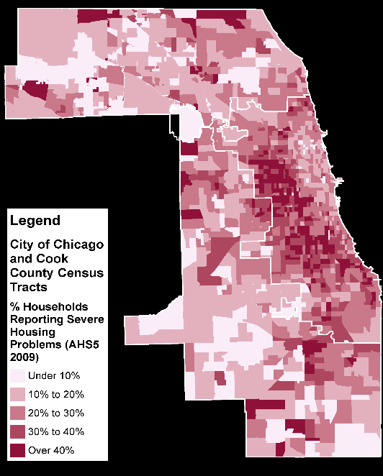
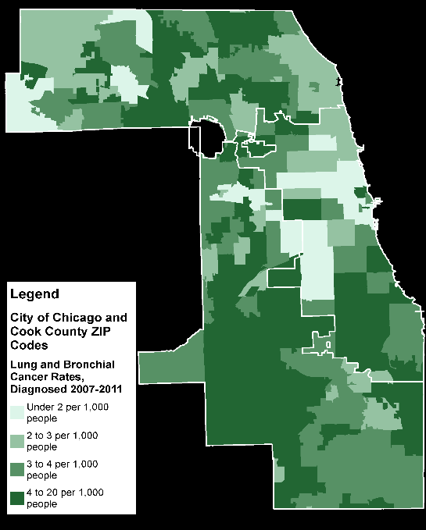
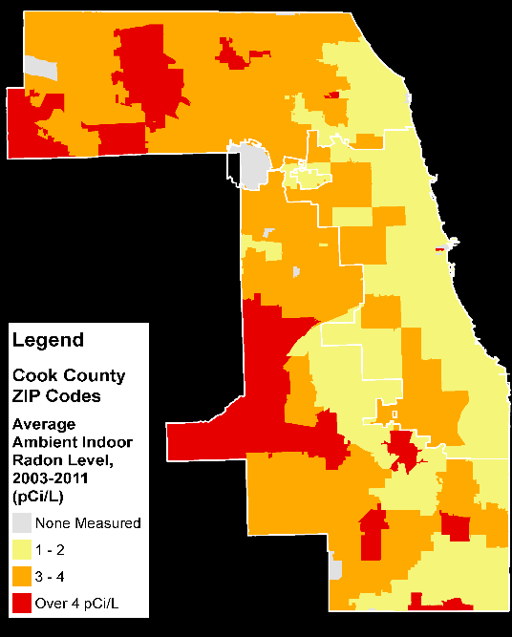
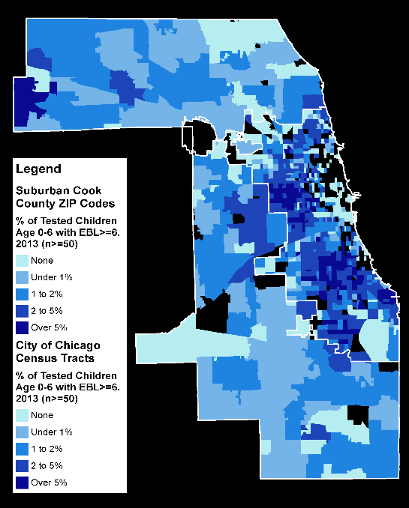
GIS Mapping Analysis
An Overview of the Problem Locally in Chicago and Cook County
David J. Treering, GIS Specialist
Institute of Environmental Sustainability
Loyola University Chicago
Notes:
Welcome everyone!
I’d like to start by thanking the Summit planning committee and the Healthy Homes Initiative Steering Committee for bringing us together today.
Thanks to the Initiative’s Advisory Council for helping guide us. I want to recognize and appreciate the participation of our federal, state, county, city, university, private and non-profit partners.
Many thanks to our distinguished guests for their welcoming remarks.
Most importantly, my thanks to all of you for being here, willing to contribute your expertise to improving health in our region by improving healthy homes.

Slide 2

Purpose of Mapping
What we hope to learn
Define particular areas within the larger region for targeted action to address particular concerns around Healthy Homes
Where problems exist and where they have been remedied
Where and for what hazards/outcomes data is lacking
Tools Used
GIS - Geographic Information Systems
A computer system designed to capture, store, manipulate, analyze, manage, and present all types of geographical data
Notes:
My question today is: Where are the homes with indoor environmental hazards most likely to be found in Chicago and Cook County?
Can we define particular areas within the larger region for targeted action to address particular concerns around Healthy Homes?
Can we find where problems exist and where they have been remedied?
An can we identify where and for what hazards and health outcomes data is lacking?
To help answer these questions I’ve used a GIS or Geographic Information System to create maps.
A GIS is a computer system designed to capture, store, manipulate, analyze, manage, and present all types of geographical data.
I use GIS mapping and public data to identify high risk communities and high probability homes.
By layering different types of information on a map, we can visualize relationships between seemingly unrelated factors.
Therein lies the power of this type of geospatial analysis: exposing relationships and explaining why things are distributed where they are.

Slide 3
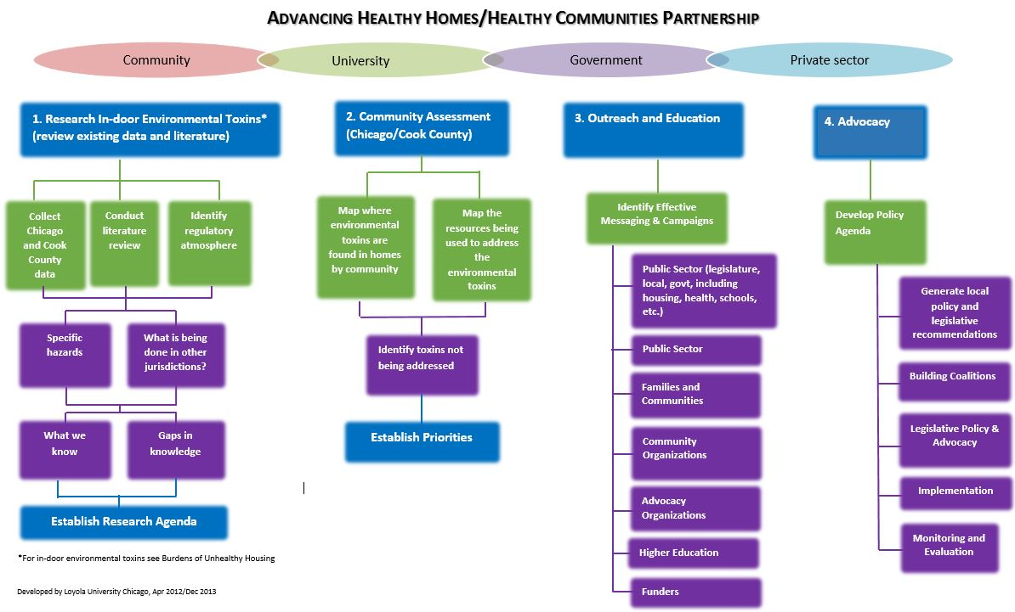
Translating the Problem
Collect
Chicago
and Cook
County
data
Map where
environmental
toxins are
found in homes
by community
Establish Priorities
Establish Research Agenda
Notes:
As you heard earlier, we began this initiative at Loyola by identifying relevant stakeholders, literature, data, policies and practices
* I began gathering and organizing data to see what is available and what gaps in knowledge and data exist. This helped us develop a research agenda, which will be expanded today, with your help.
* Mapping information on indoor environmental hazards and health disparities came next. I’ll be showing you preliminary results of this mapping effort to inform the discussions later today. The maps are available online, so I’ll move through them rather quickly.

Slide 4
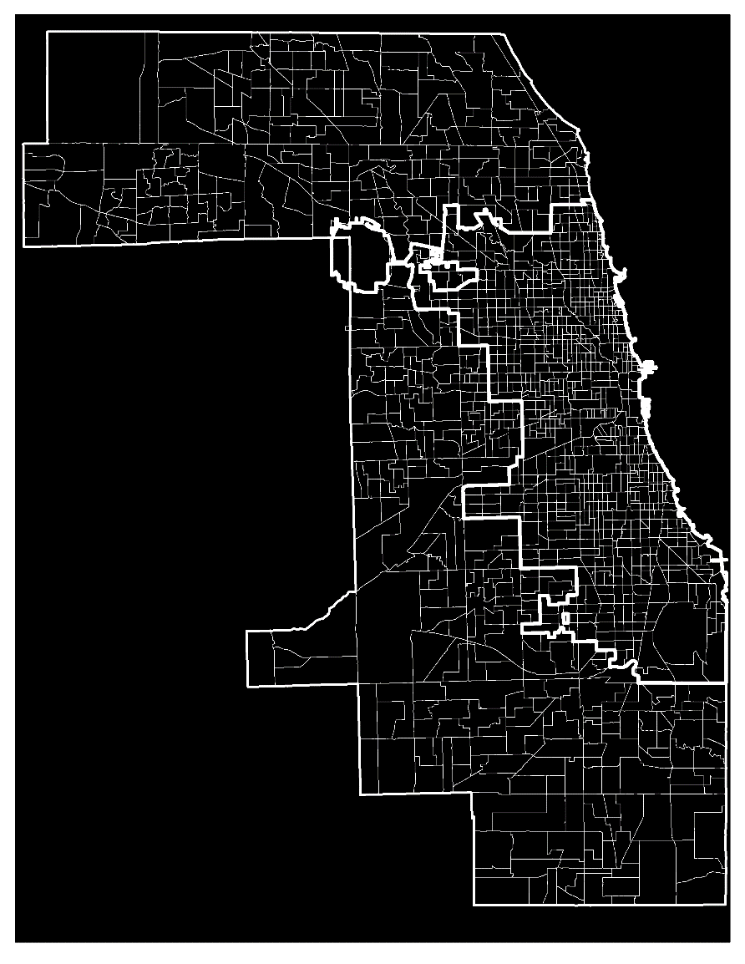
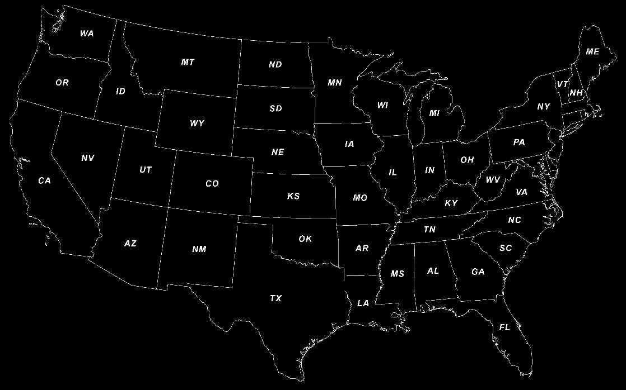
Scope: Chicago and Cook County
Units of Geography
  Tracts (1,318)
  ZIP Codes (191)
  Municipalities (173)
Notes:
I first want to make sure everyone is oriented correctly.
You can see here the scope of our mapping effort to date is the City of Chicago and Cook County. In order to make direct comparisons between layers in the GIS, we used the smallest available geographic unit possible to collect our data.
In most cases this was the Census Tract, shown here. Tracts are an aggregation of actual city blocks with populations around 4,000 people each. The rest of the data was available at the Postal ZIP Code or municipality level.
These smaller geographies let us visualize the subtle or dramatic differences WITHIN neighborhoods, within cities, improving our ability to target our recommendations and actions.

Slide 5
Approach and Dataset Collection
Data brainstorming with partners to develop a wish list for collection
  Socioeconomic and Demographic data
  Physical Building and Environmental Quality data
  Public Health Outcome and Intervention data
Visualizing the spatial relationships helps identify areas of greatest need
Socioeconomic
Poverty and Income
Health Insurance
Occupancy Status (Rent/Own)
Foreclosures and Vacancy
Physical Environment
Building Age and Type
Building Code Violations
Poison Control Center Calls
311 Service Calls
Radon Test Levels
Building and Renovation Permits
Substandard Housing Problems
Public Health
Lead Inspections
Elevated Blood Lead Level
Asthma Prevalence
Lung Cancer
Fire and CO Injuries
Notes:
Working with our partners, I developed a comprehensive list of data to be collected. Some of the main information is listed below.
Data falls into three categories:
1st, Socioeconomic and Demographic data
2nd, Physical Building and Environmental Quality data
And 3rd, Public Health Outcome and Intervention data
The ability to visualize spatial relationships between data layers in these categories helps identify areas of greatest need.

Slide 6
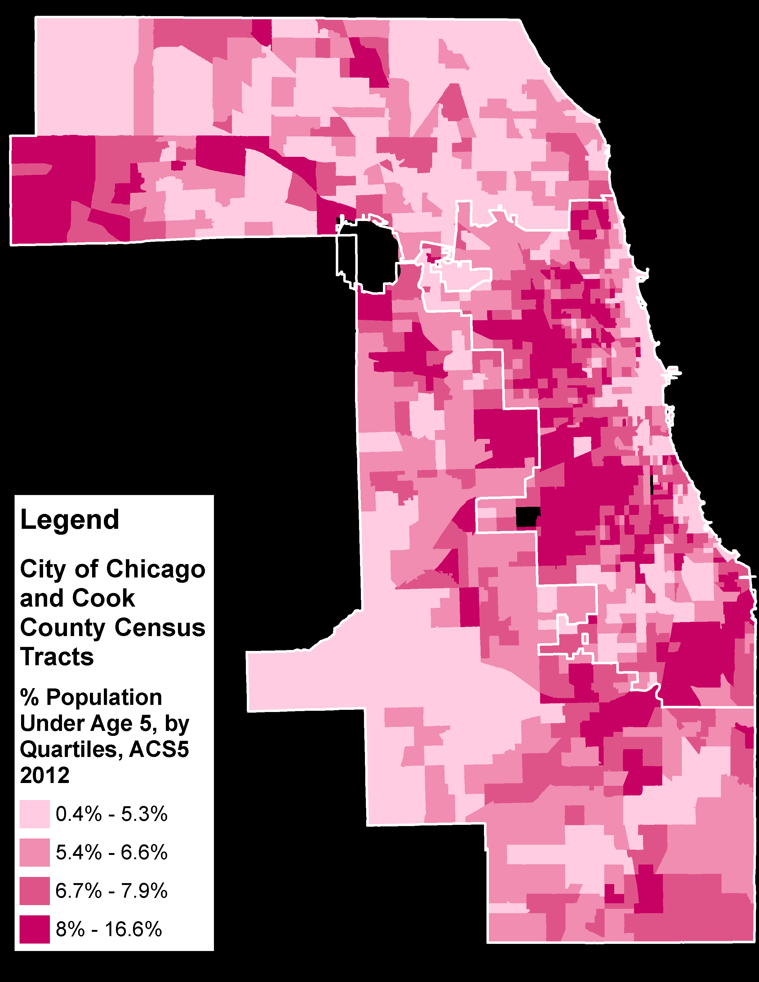
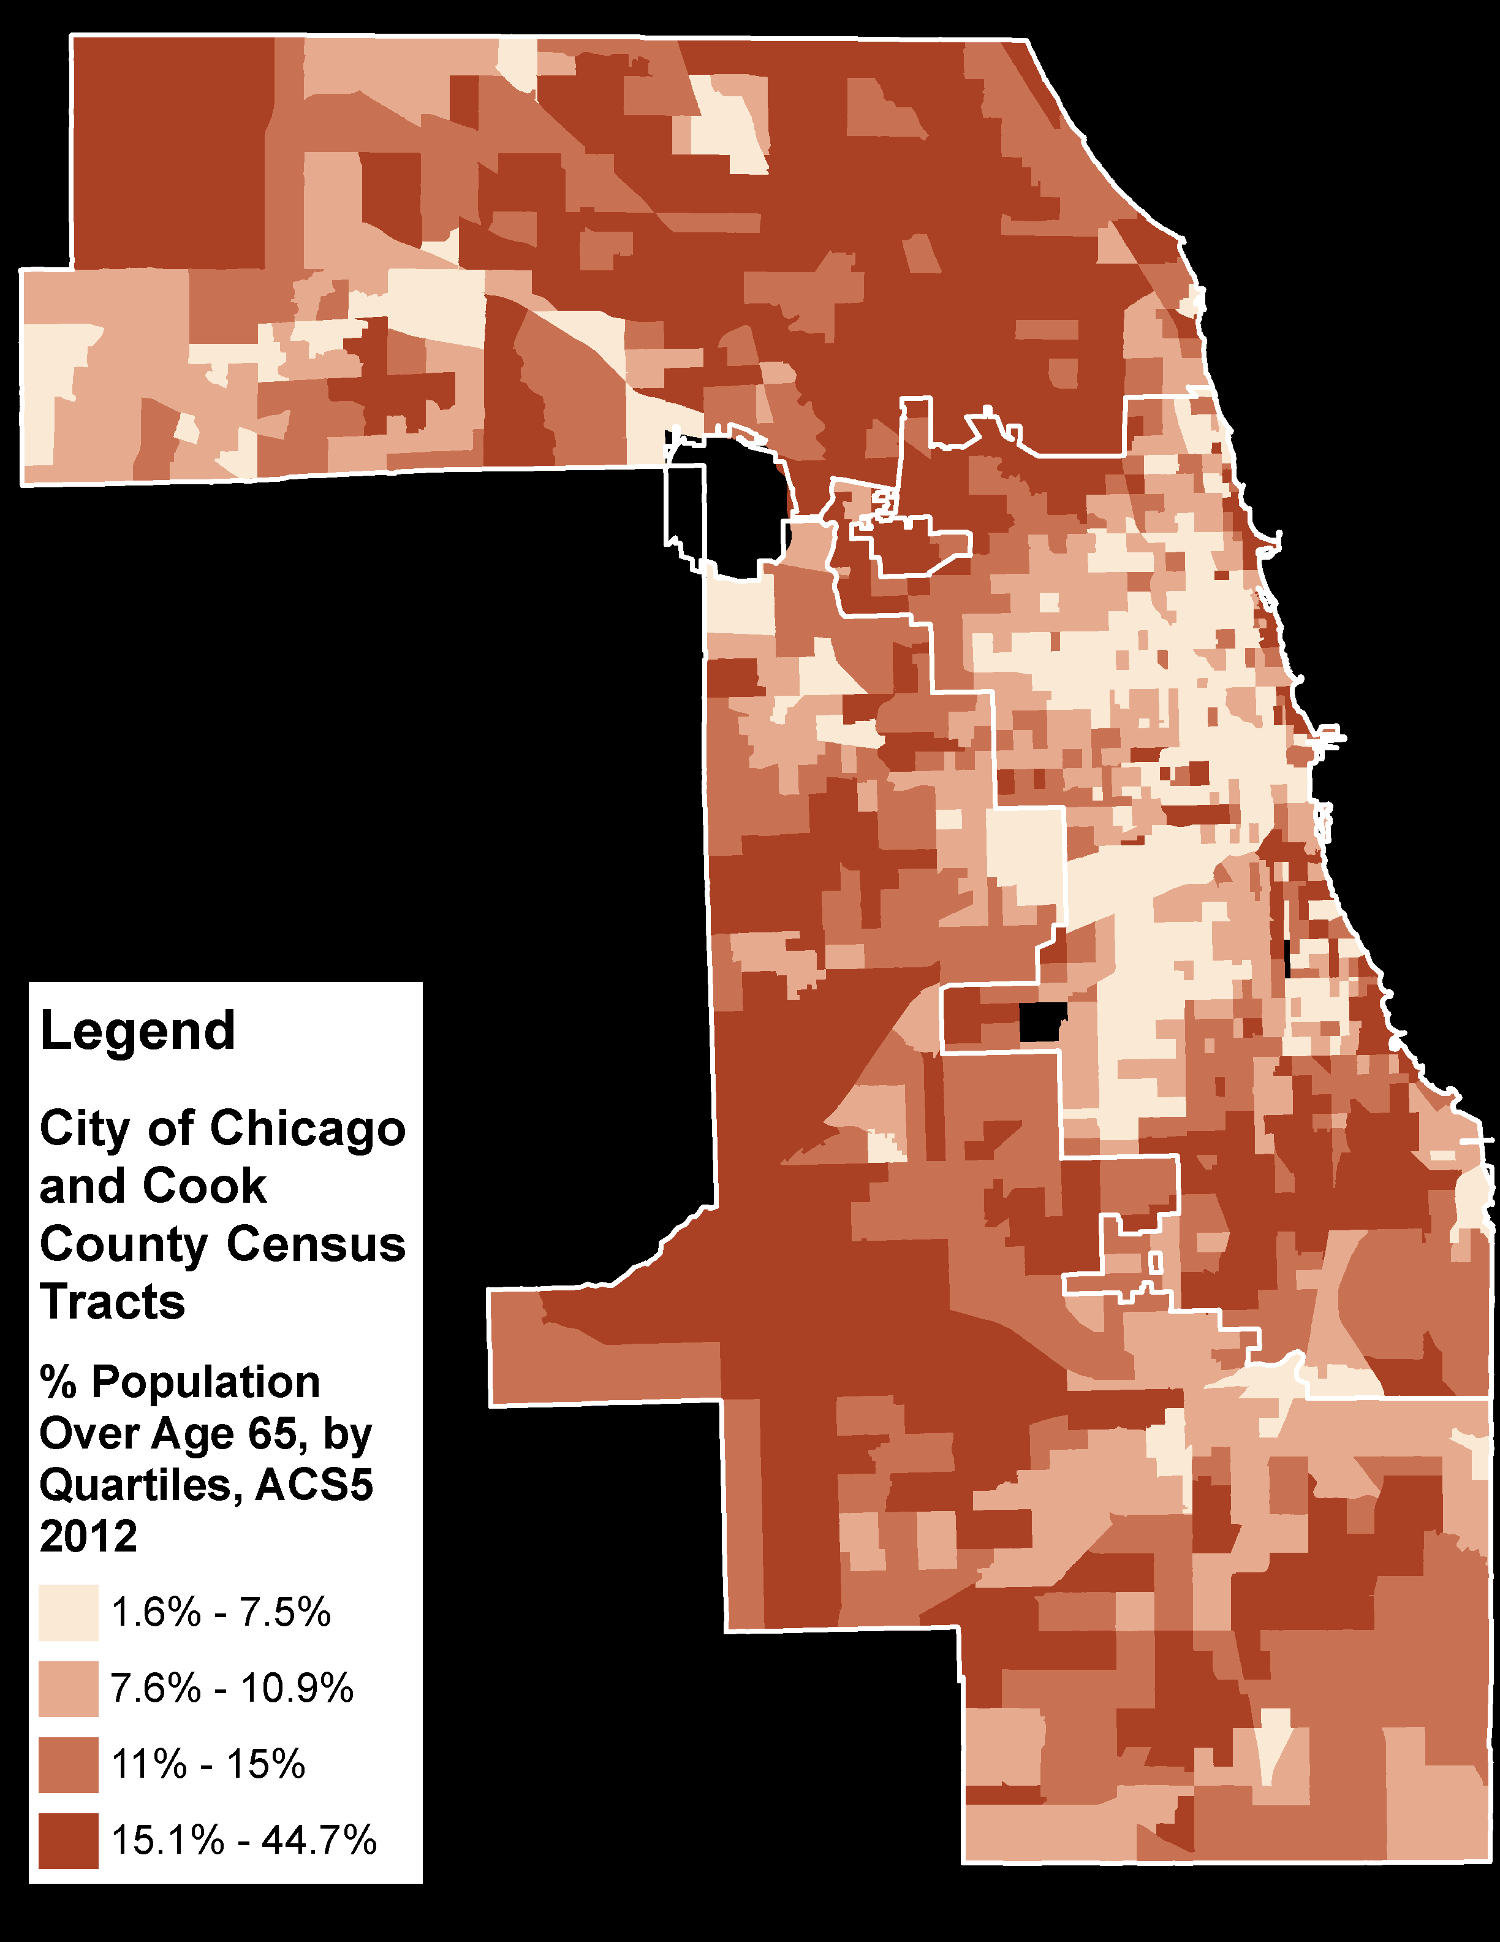
Socioeconomic & Demographic Factors: Age
% of Population Under Age 5
% of Population
Over Age 65
Tracts
Tracts
Notes:
First, we’ll look at some of the demographic and socioeconomic characteristics of the County. We need to understand where the most vulnerable people live in order to protect them.
Young children, on the left, are the most susceptible to healthy homes hazards, and the elderly, on the right, also are particularly vulnerable. These maps are nearly the inverse of each other, meaning targeted outreach and interventions can be tailored for these population groups.

Slide 7
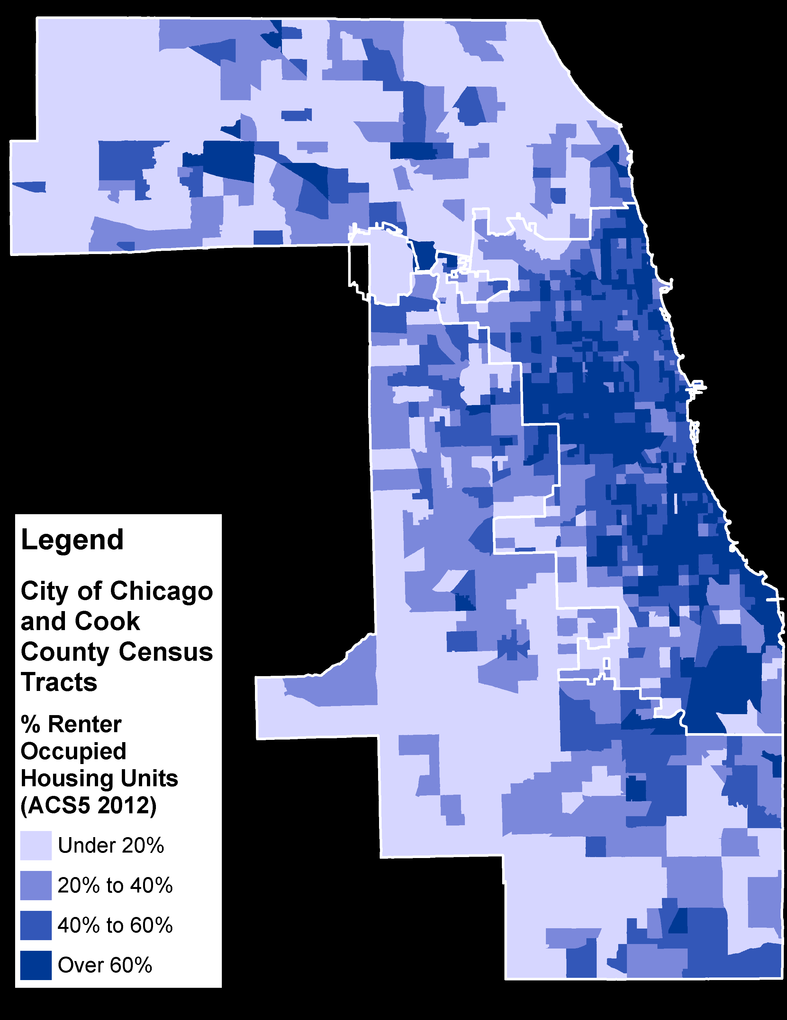
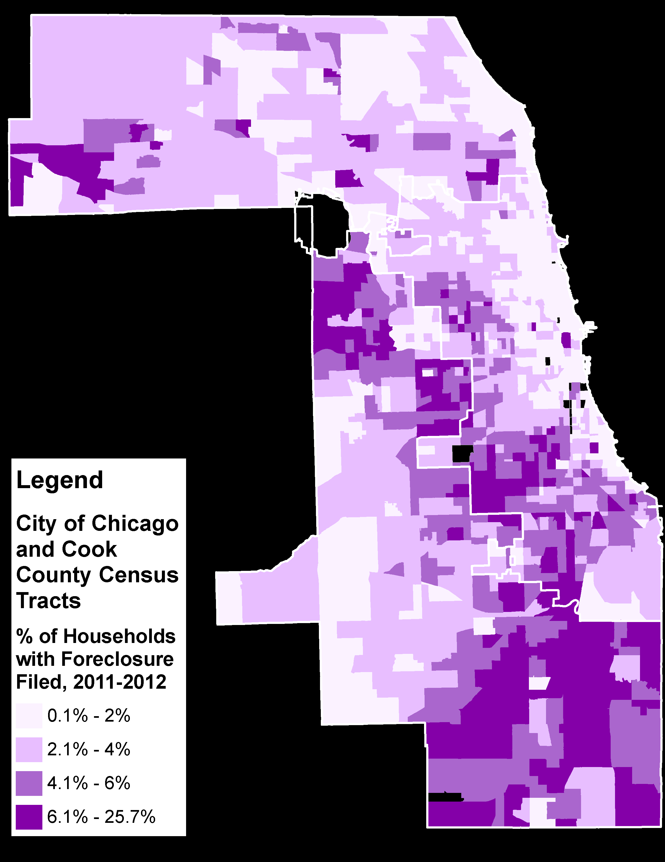
Socioeconomic & Demographic Factors: Housing
Renter Fraction of Households
% Households with Foreclosure Filed
Tracts
Tracts
Notes:
Among housing variables, we gathered data on renter occupied housing units, on the left, and recent foreclosures, on the right.
There is a clear need for advocacy on behalf of renters to ensure they are able to live in healthy, dignified conditions.
Foreclosures have been linked to mental health consequences, as well as a lack of general maintenance and repair. Housing conditions can deteriorate quickly if a unit is left vacant.

Slide 8
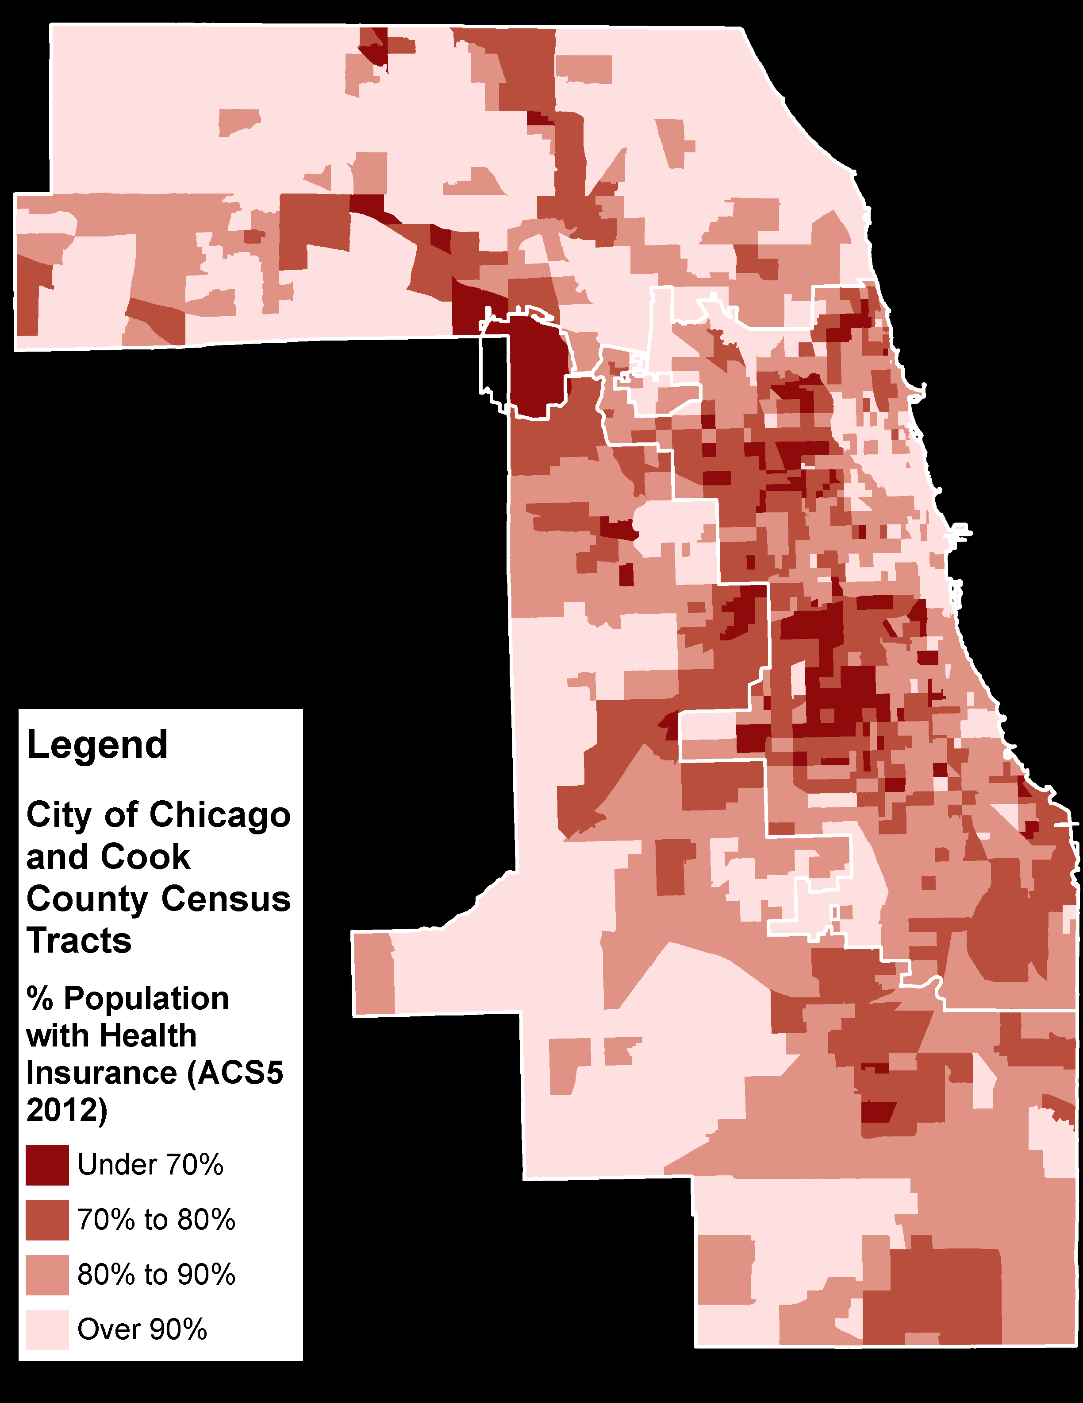
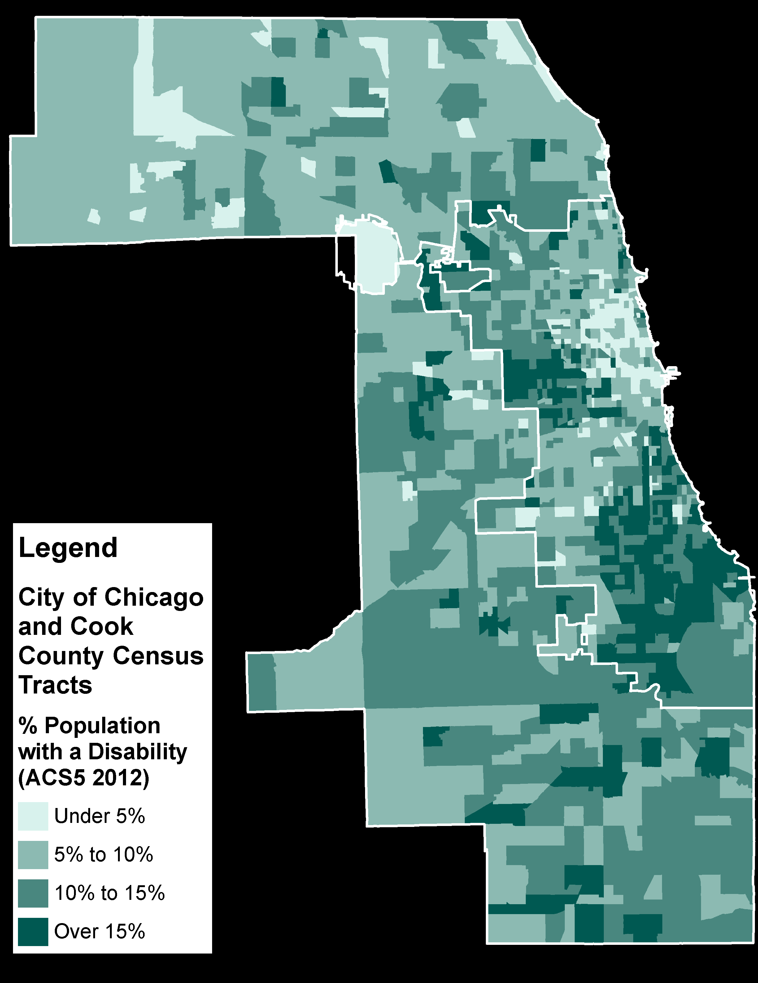
Socioeconomic & Demographic Factors: Health
% of Population with Health Insurance
% of Population with a Disability
Tracts
Tracts
Notes:
Another tragedy is that those least able to afford caring for their families are some of the most severely affected by healthy homes hazards.
We see here areas of low health insurance on the left and high disability rates on the right.
(Pause)

Slide 9
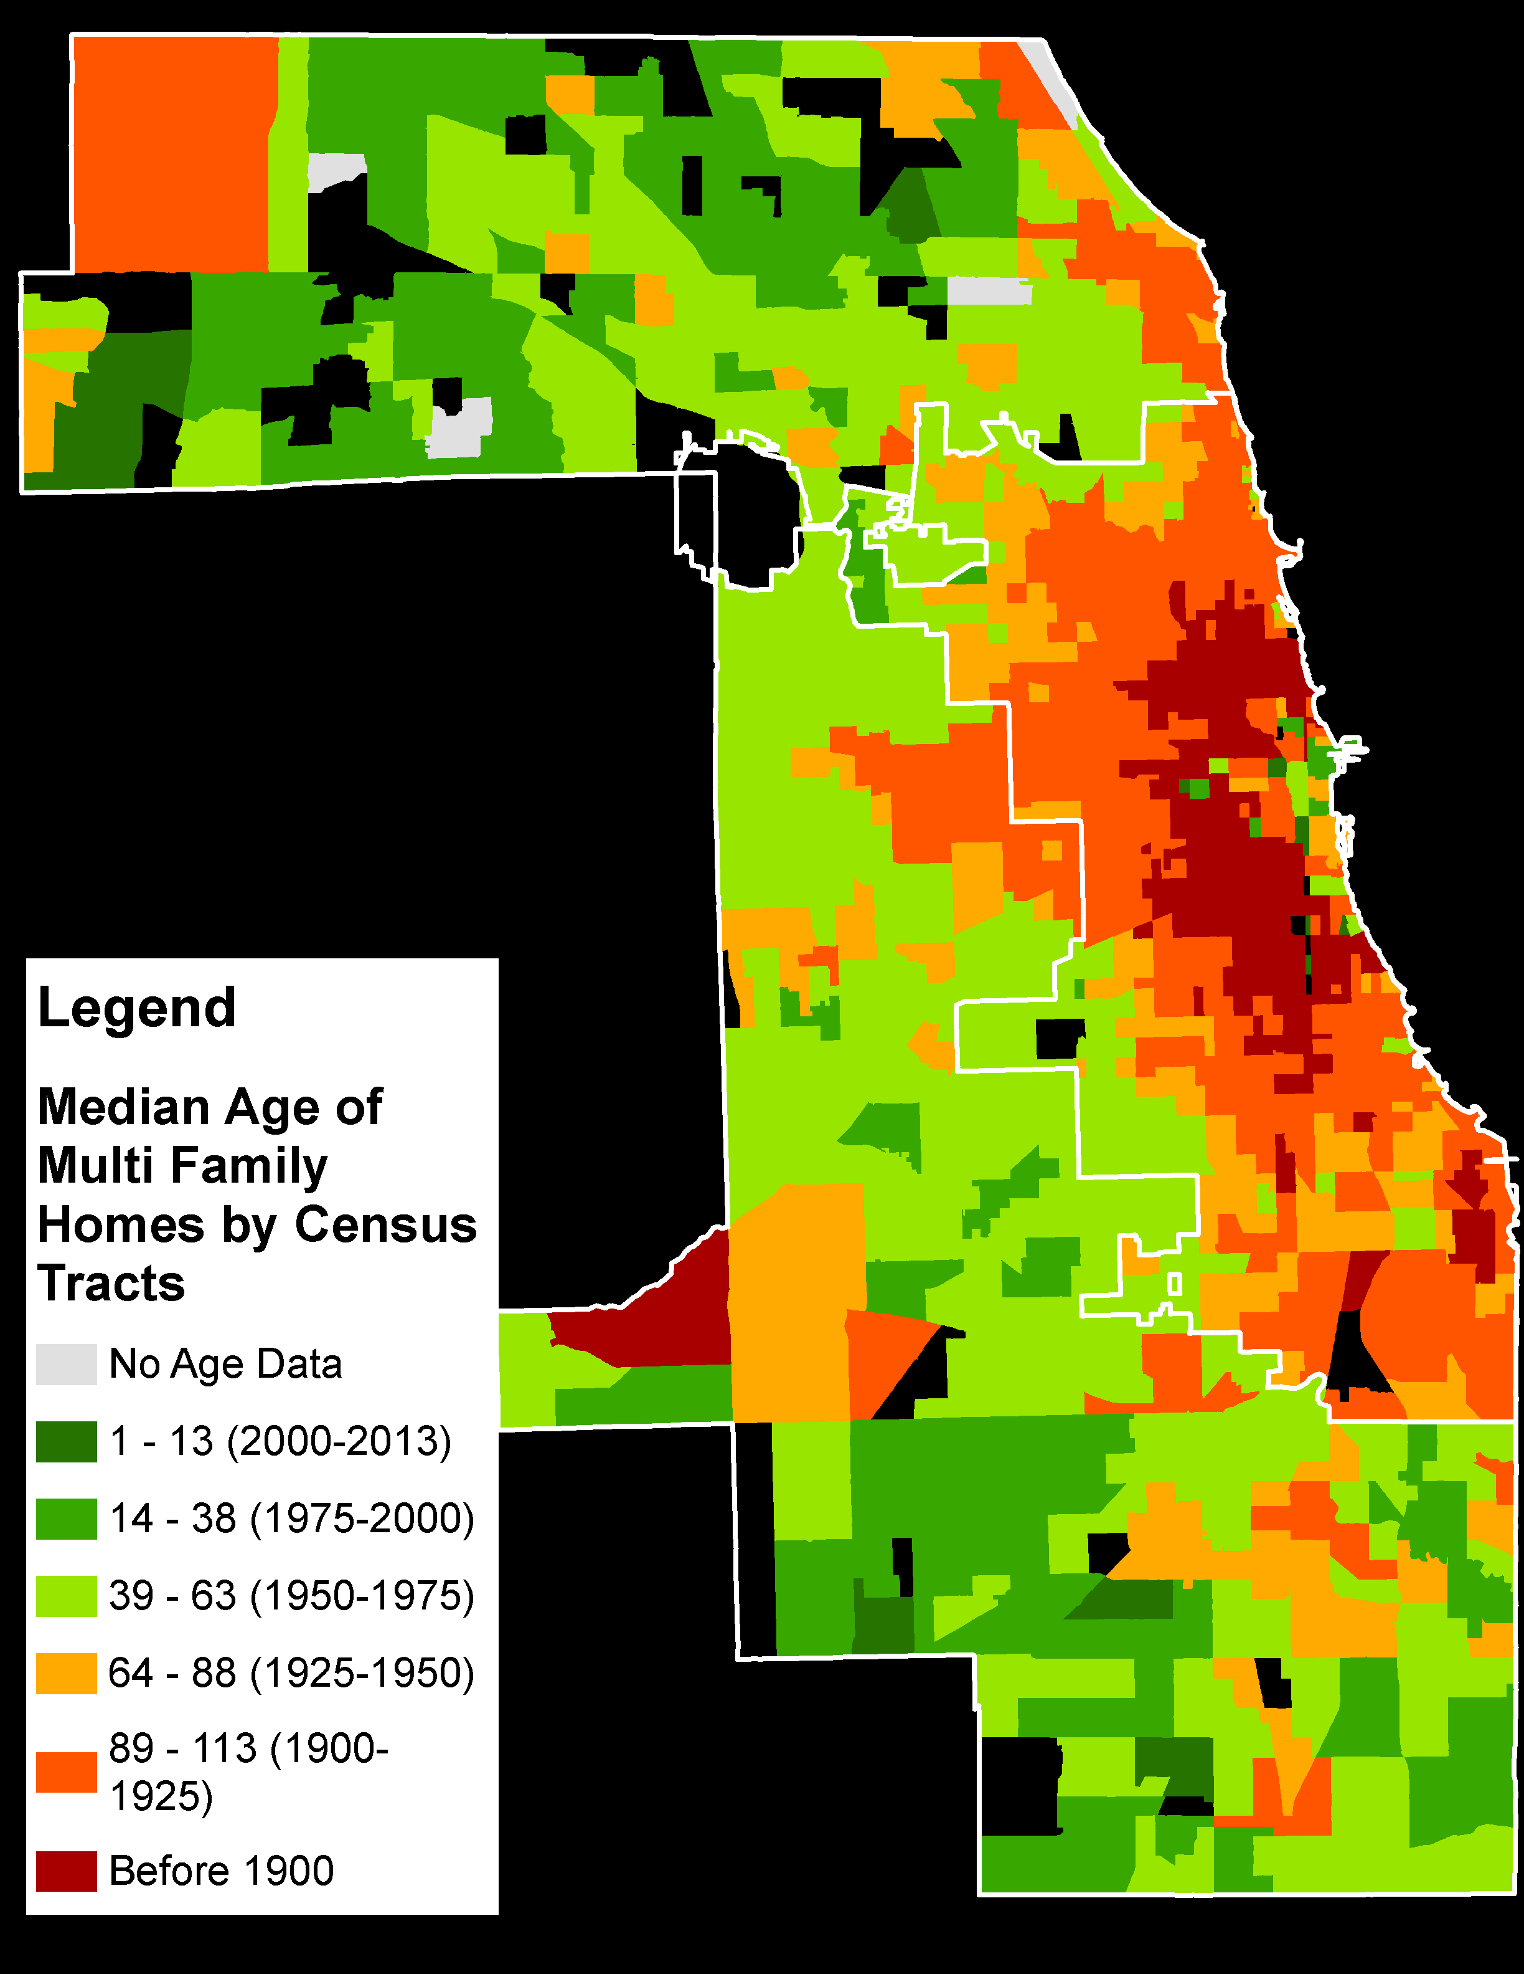
Median Age of Multi Family Residential Buildings
Cook County Assessor data by Parcel
Summarized the Age of Buildings in each Census Tract.
Median Age shows the central value within each Tract
Very old multi family units are pervasive
Median Age
By Tract
Tracts
Notes:
After defining some of the vulnerable populations on the map using socioeconomic and demographic information, we turn our attention now to the Physical, Built Environment – the structure of homes.
We can pinpoint addresses by the age of the building using Parcel data from the County Assessor. To see general patterns of building age across the county, I’ve shown the Median Age of Multi-Family Residential homes in this map.
You can see just how pervasive very old housing is in our region.

Slide 10
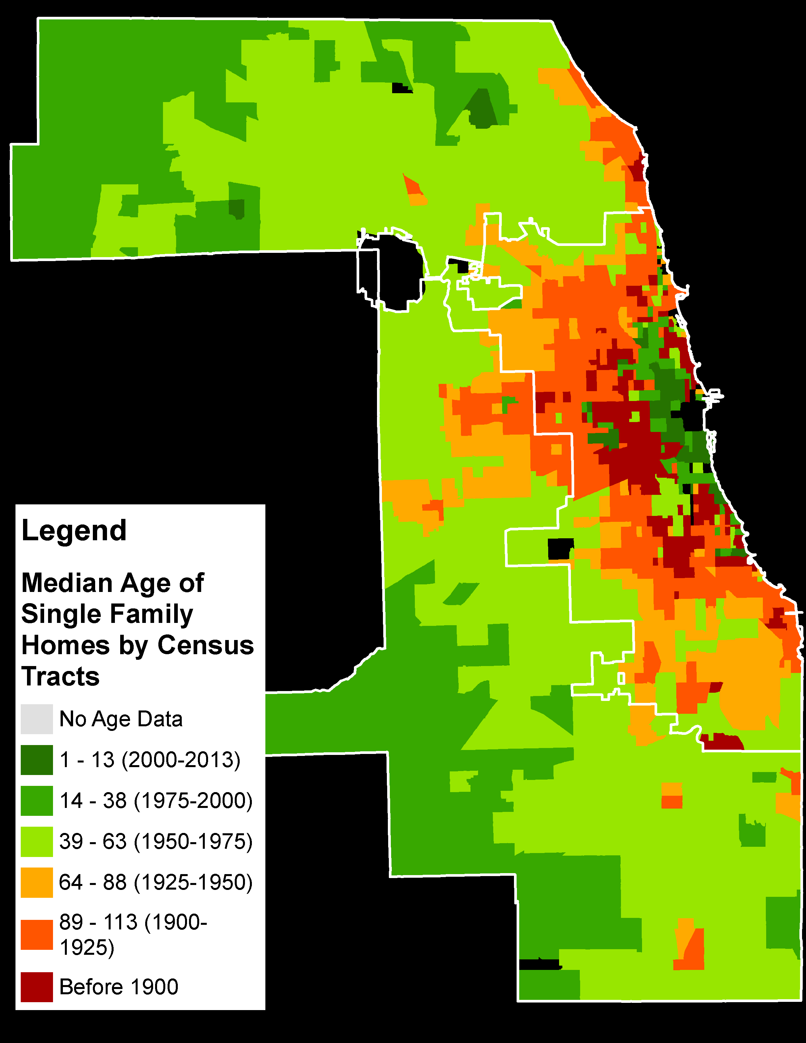
Median Age of Single Family Residential Buildings
Cook County Assessor data by Parcel
Summarized the Age of Buildings in each Census Tract.
Median Age shows the central value within each Tract
Very old single family units are pervasive throughout Cook County
Median Age
By Tract
Tracts
Notes:
The distinction between Single Family and Multi Family homes is an important one when we move into the implementation of our plans.
Single Family homeowners may have different motivations when it comes to property repair and remediation. Here we see the median age of Single Family homes by Census Tract.

Slide 11
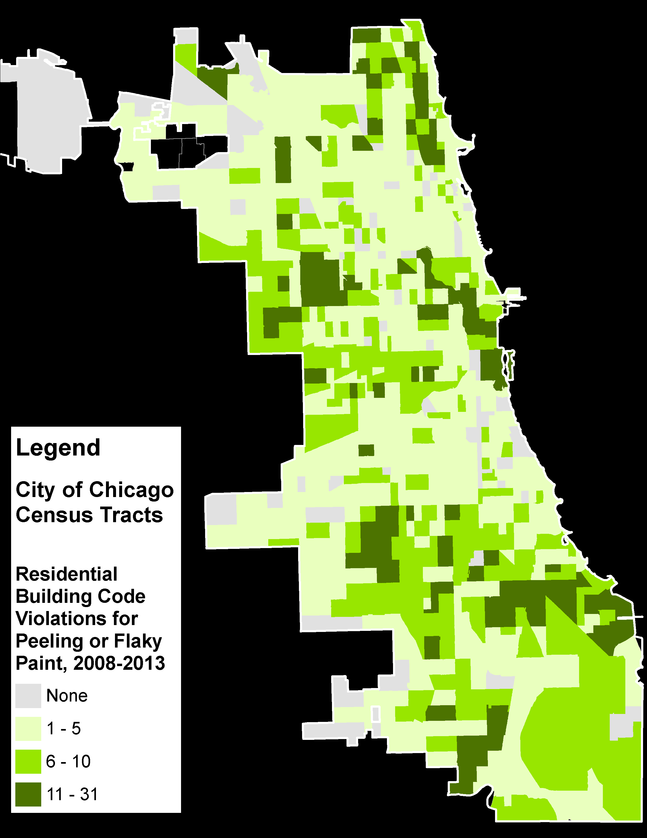
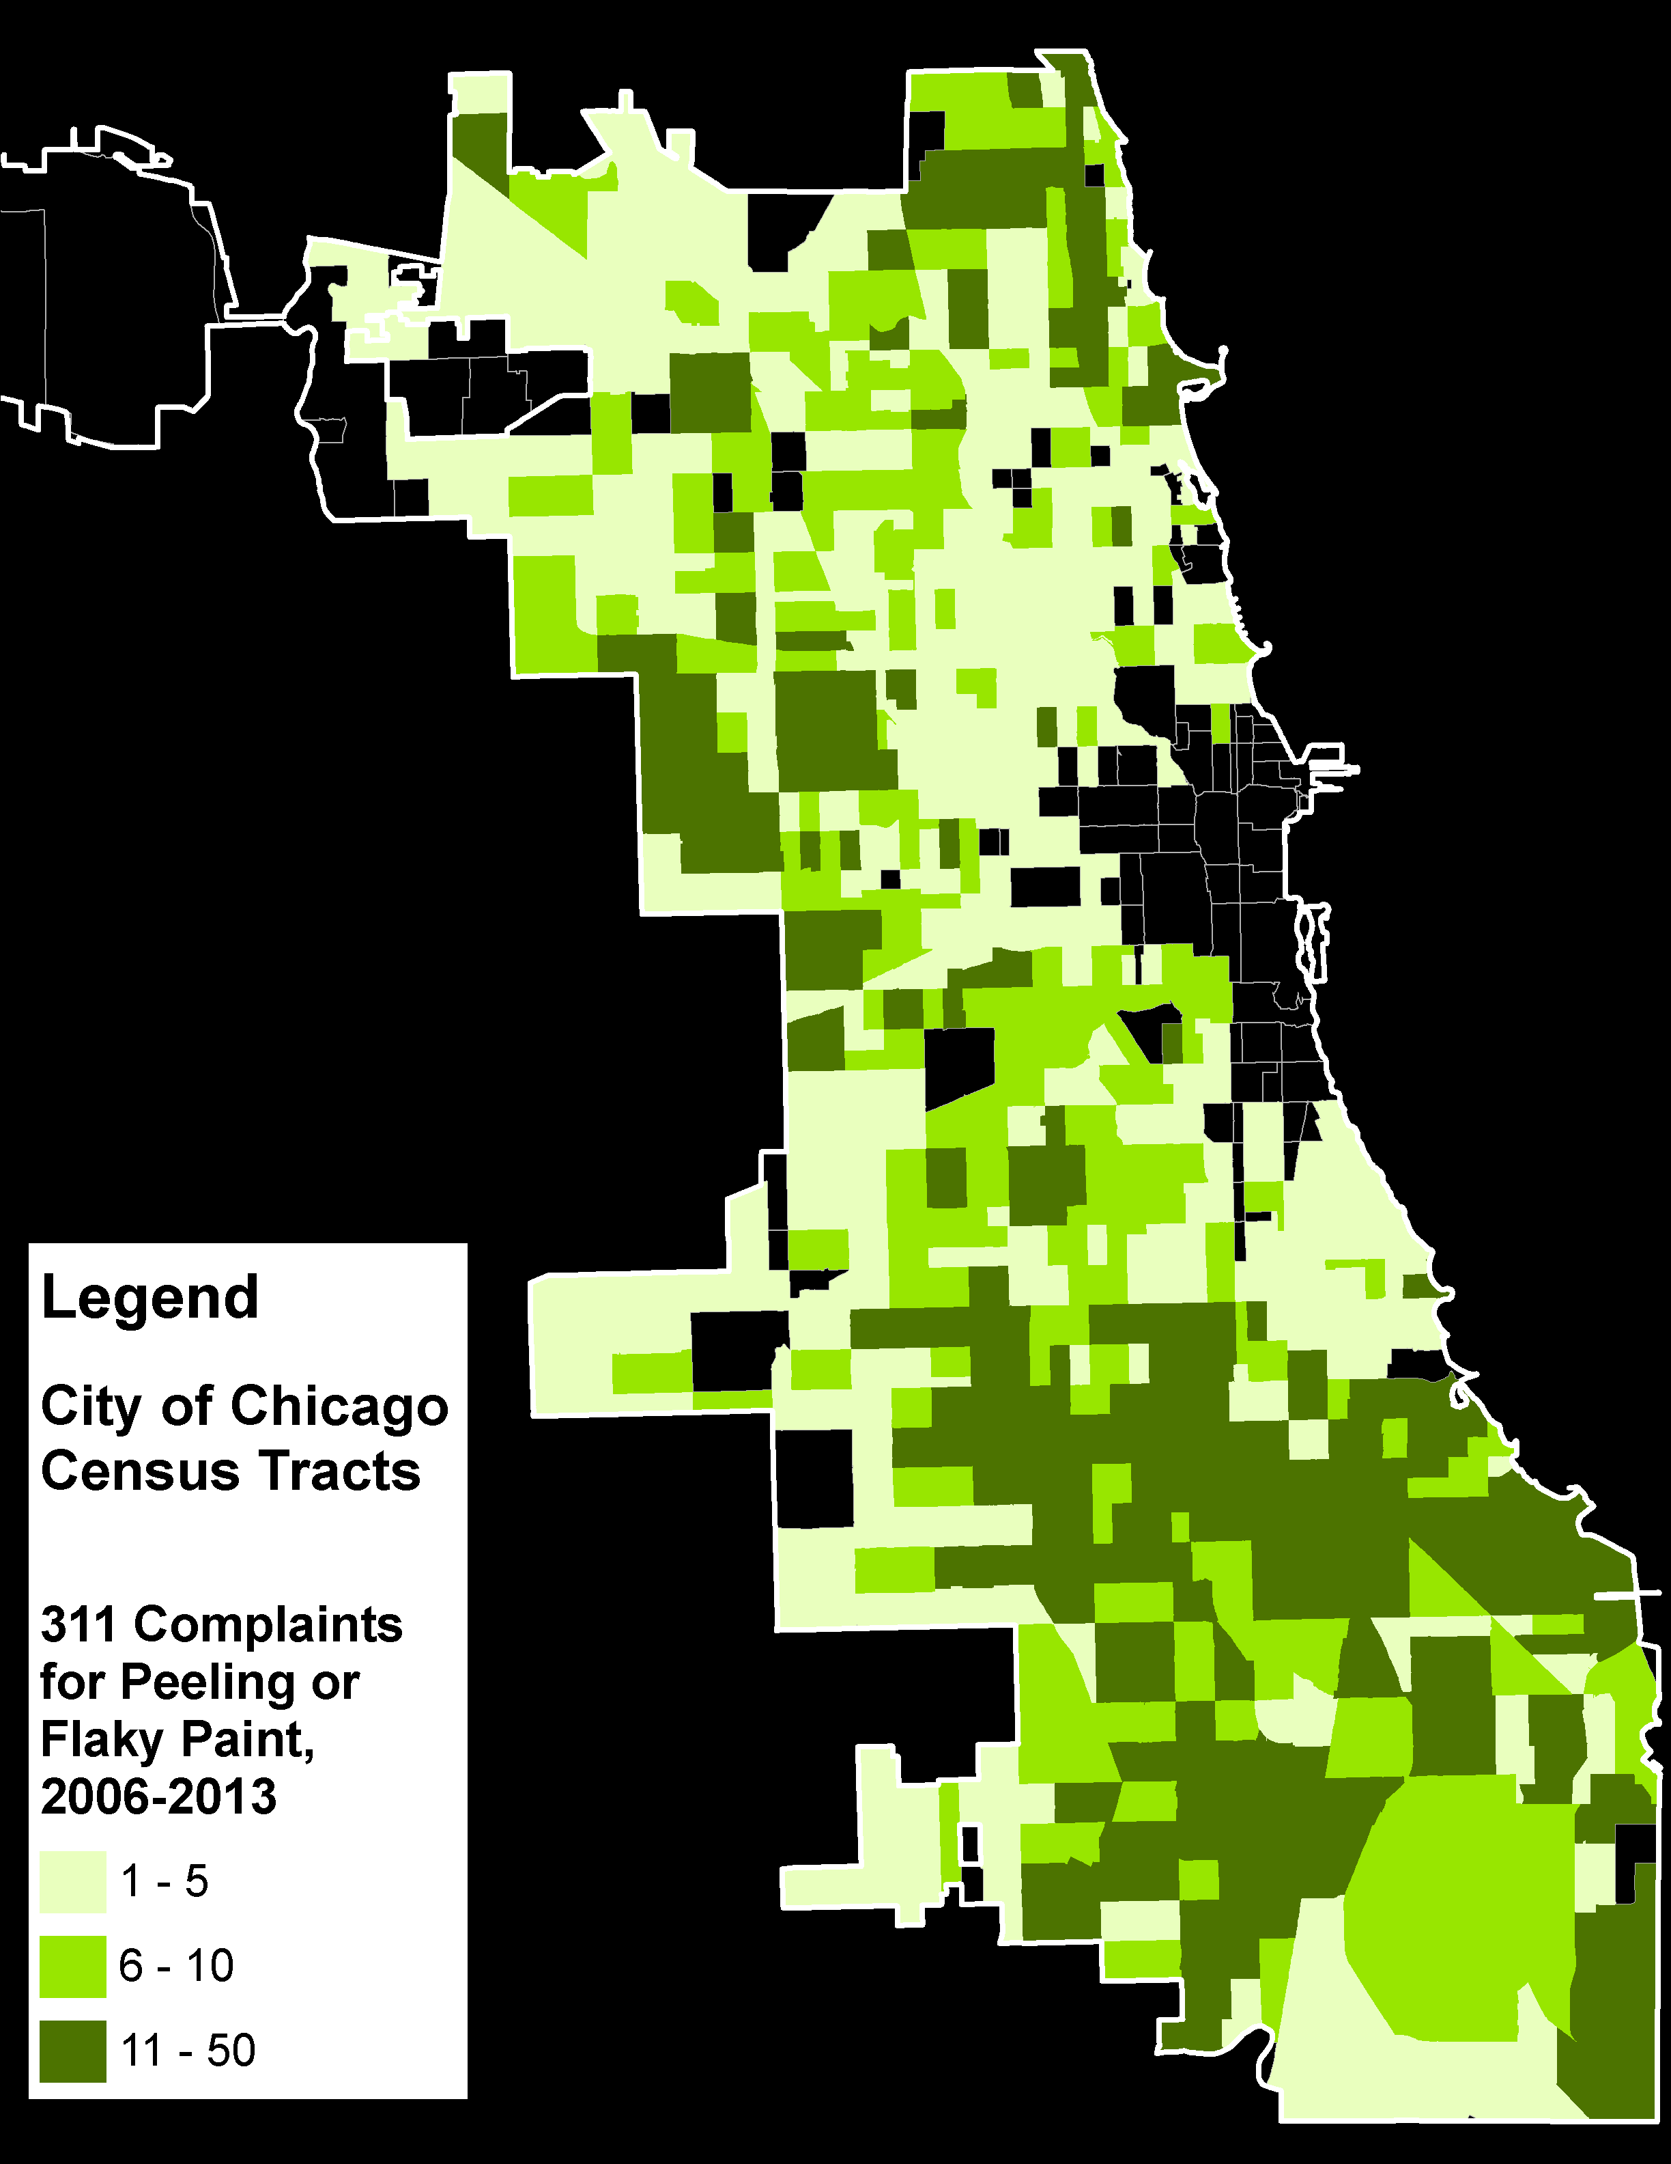
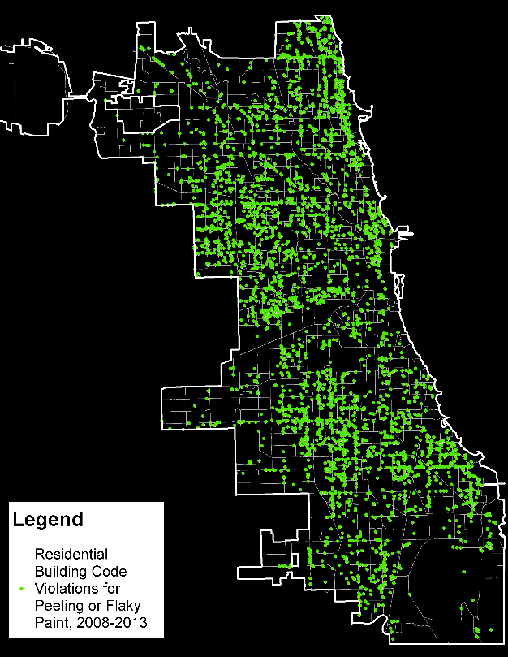
Code Violations for Peeling Paint
Building Code Violations for Flaky or Peeling Interior Paint in Residential Buildings, 2008-2013
City of Chicago 311 Complaints for Peeling or Flaky Paint, 2006-2013
Points
Tracts
Tracts
Notes:
The City Department of Buildings cites owners for code violations, one of which is for flaky or peeling interior paint. 311 calls also provide address level reports on paint problems. This can help us understand where exposure to lead paint might be higher.
Taking these point locations of violations and 311 Complaints and summarizing them by Census Tract, we can see clear patterns that were more difficult to see with just the points.
Now admittedly, this data comes only from where building inspections were done, and only from where someone decided to place that 311 call, but it provides another valuable perspective to help locate the hazard of flaky, peeling lead paint in older homes.

Slide 12
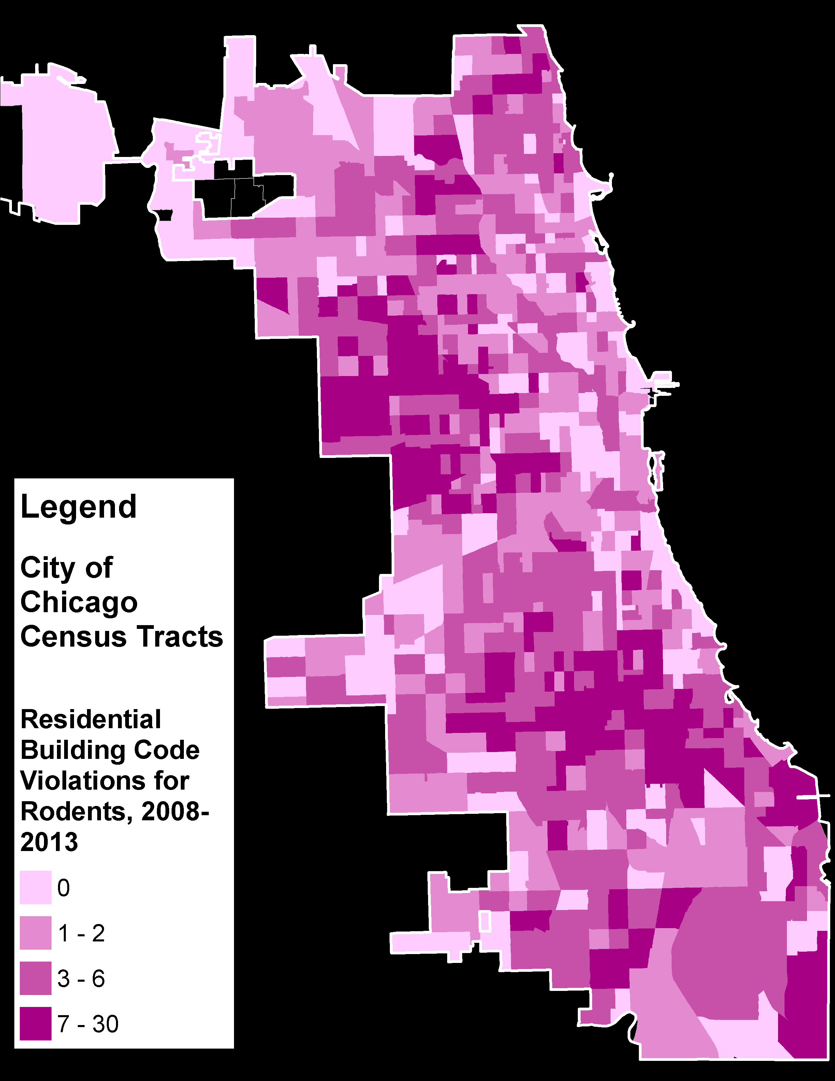
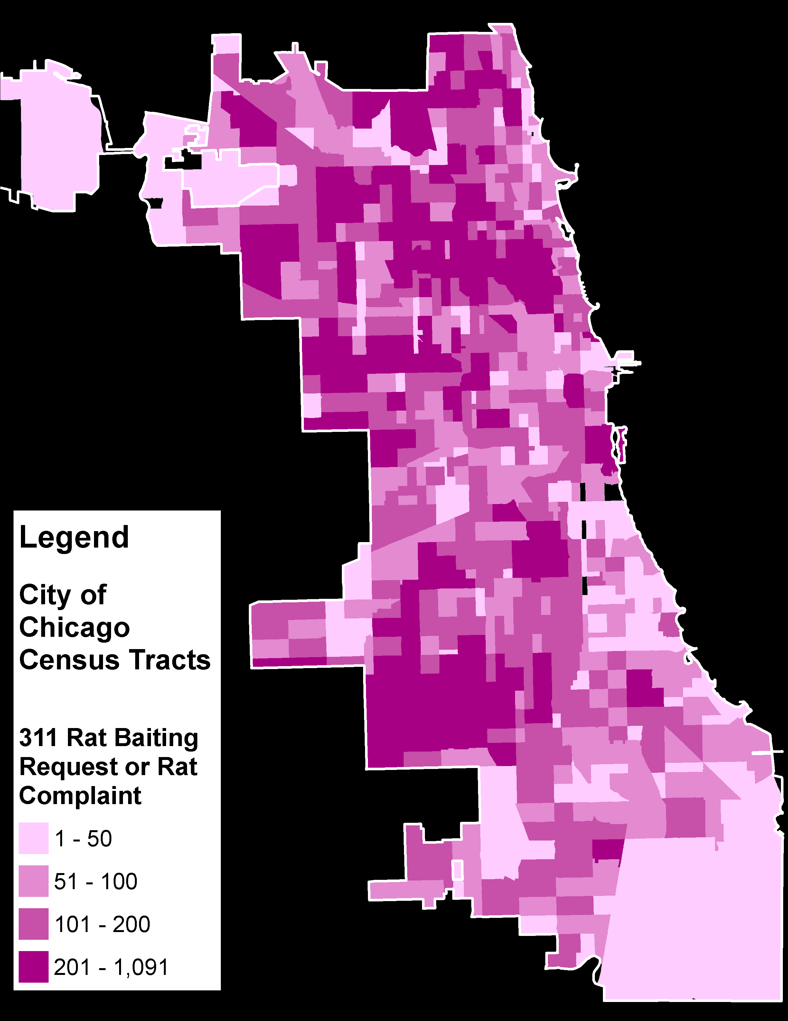
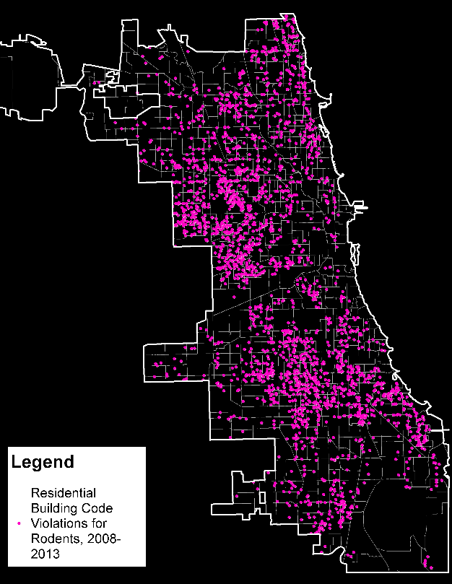
Code Violations & 311 Complaints for Rodents
Chicago Building Code Violations for Rats, Mice or Rodents in Residential Buildings, 2008-2013
City of Chicago 311 Request/Complaints for Rat Baiting, 2006-2013
Points
Tracts
Tracts
Notes:
The next physical environment factor is rodents. Rats and mice leave urine trails and their presence in a home can negatively affect asthma symptoms.
Two Chicago data sources were found to have reports on rodents: Building code violations, on the left, and 311 Requests for Rat Baiting, on the right.
These maps show the large concentrations of elevated rodent populations, with rat baiting being an outdoor activity that indicates potential for indoor exposures.

Slide 13
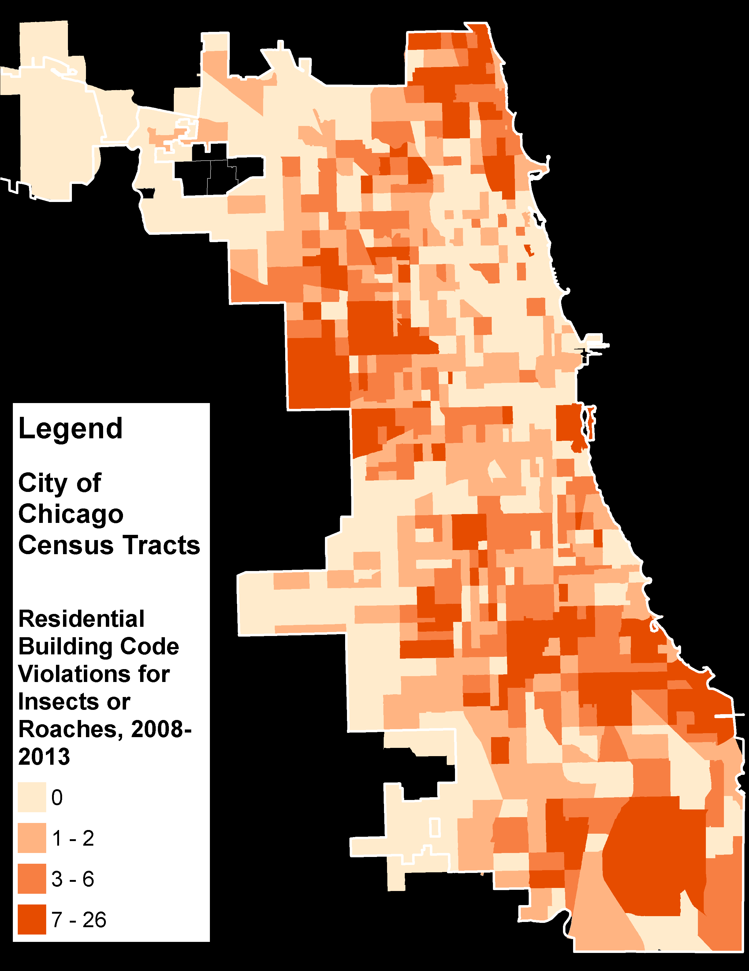
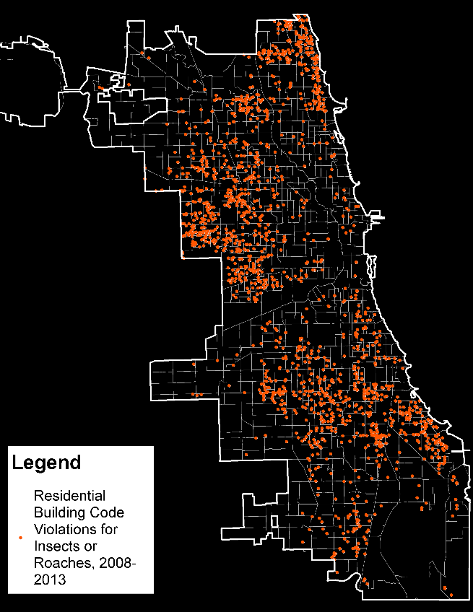
Code Violations for Presence of Roaches or Insects , 2006-13
Building Code Violations, 2006-2013 for Presence of Roaches or other Insects in Residential Buildings
Summarized as a Count per Census Tract
Points
Tracts
Notes:
Roaches are another contributor to allergens and asthma triggers, as Dr. Binns explained. Again the code violations show us the spatial distribution of roaches in Chicago.

Slide 14
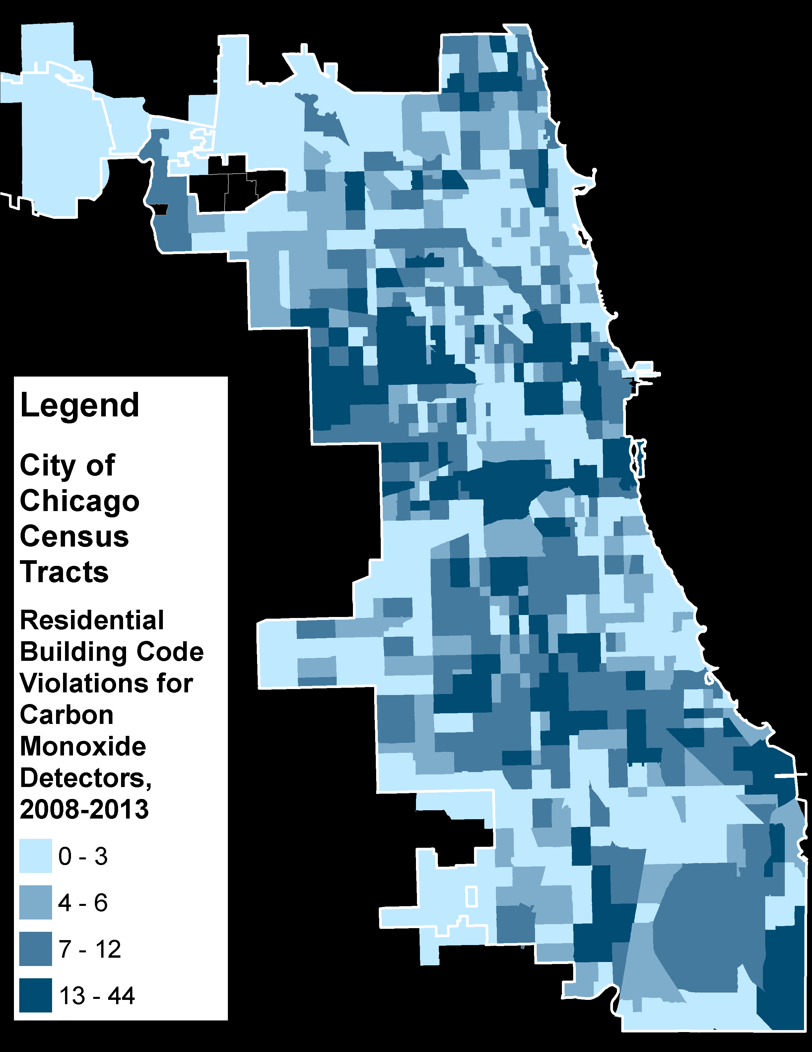
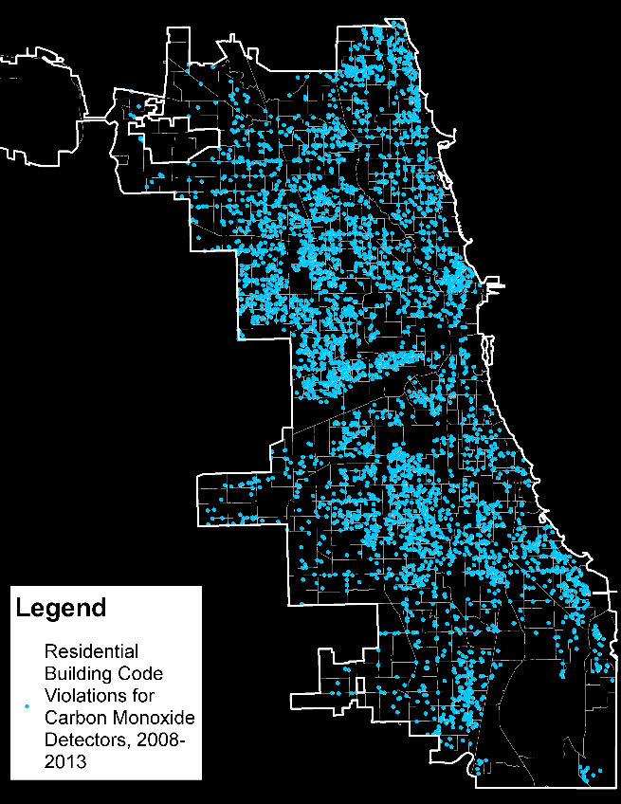
Code Violations for Missing Carbon Monoxide Detector, 2006-13
Building Code Violations, 2006-2013 for Missing Carbon Monoxide Detector in Residential Buildings
Summarized as a Count per Census Tract
Points
Tracts
Notes:
Here are code violations for missing Carbon Monoxide detectors, an easy preventative measure against injury.

Slide 15

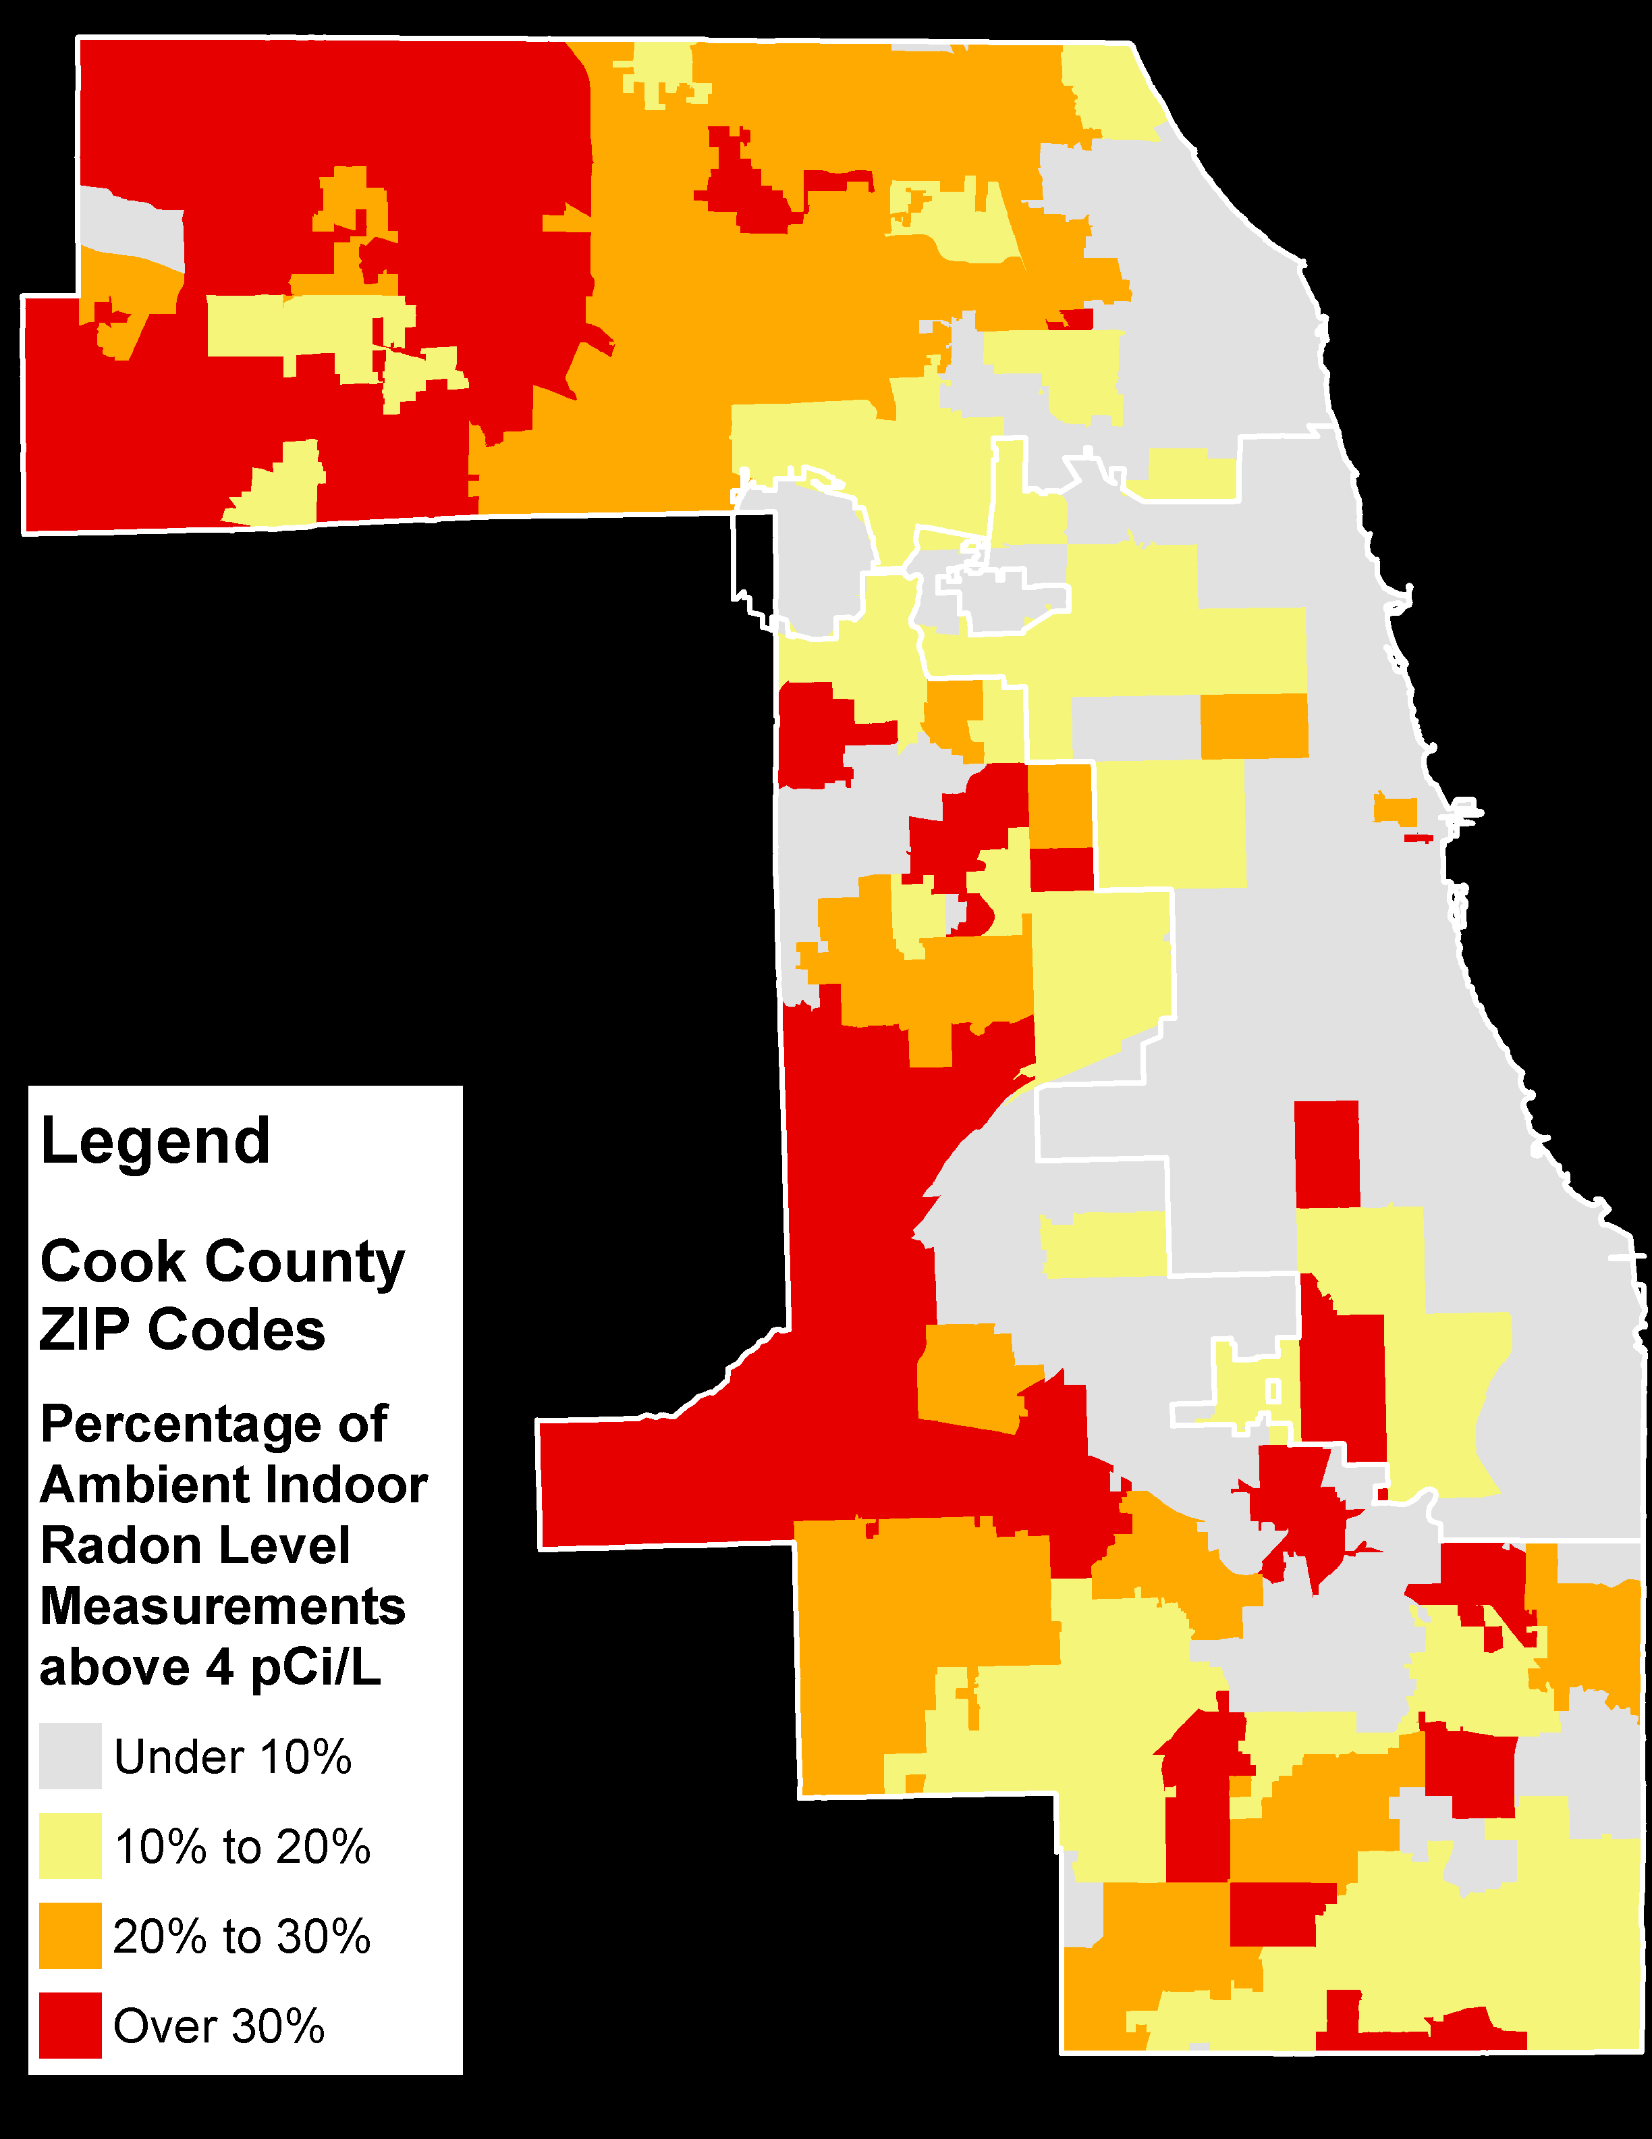
Radon Gas Measurements
% with Dangerous Level
Average Level
ZIP Codes
ZIP Codes
Notes:
Indoor radon exposure is the second leading cause of lung cancer in the US. Radon gas is an infrastructure problem that can be mitigated if found at dangerous levels.
I found that although the overall average level for Cook County was quite low, there are specific clusters with elevated levels.
These readings are from the Illinois Emergency Management Agency (IEMA) and show the average ambient indoor radon level by ZIP Code on the left, and on the right, the percentage of measurements in each ZIP code above the hazardous level of 4 picocuries per Liter.

Slide 16
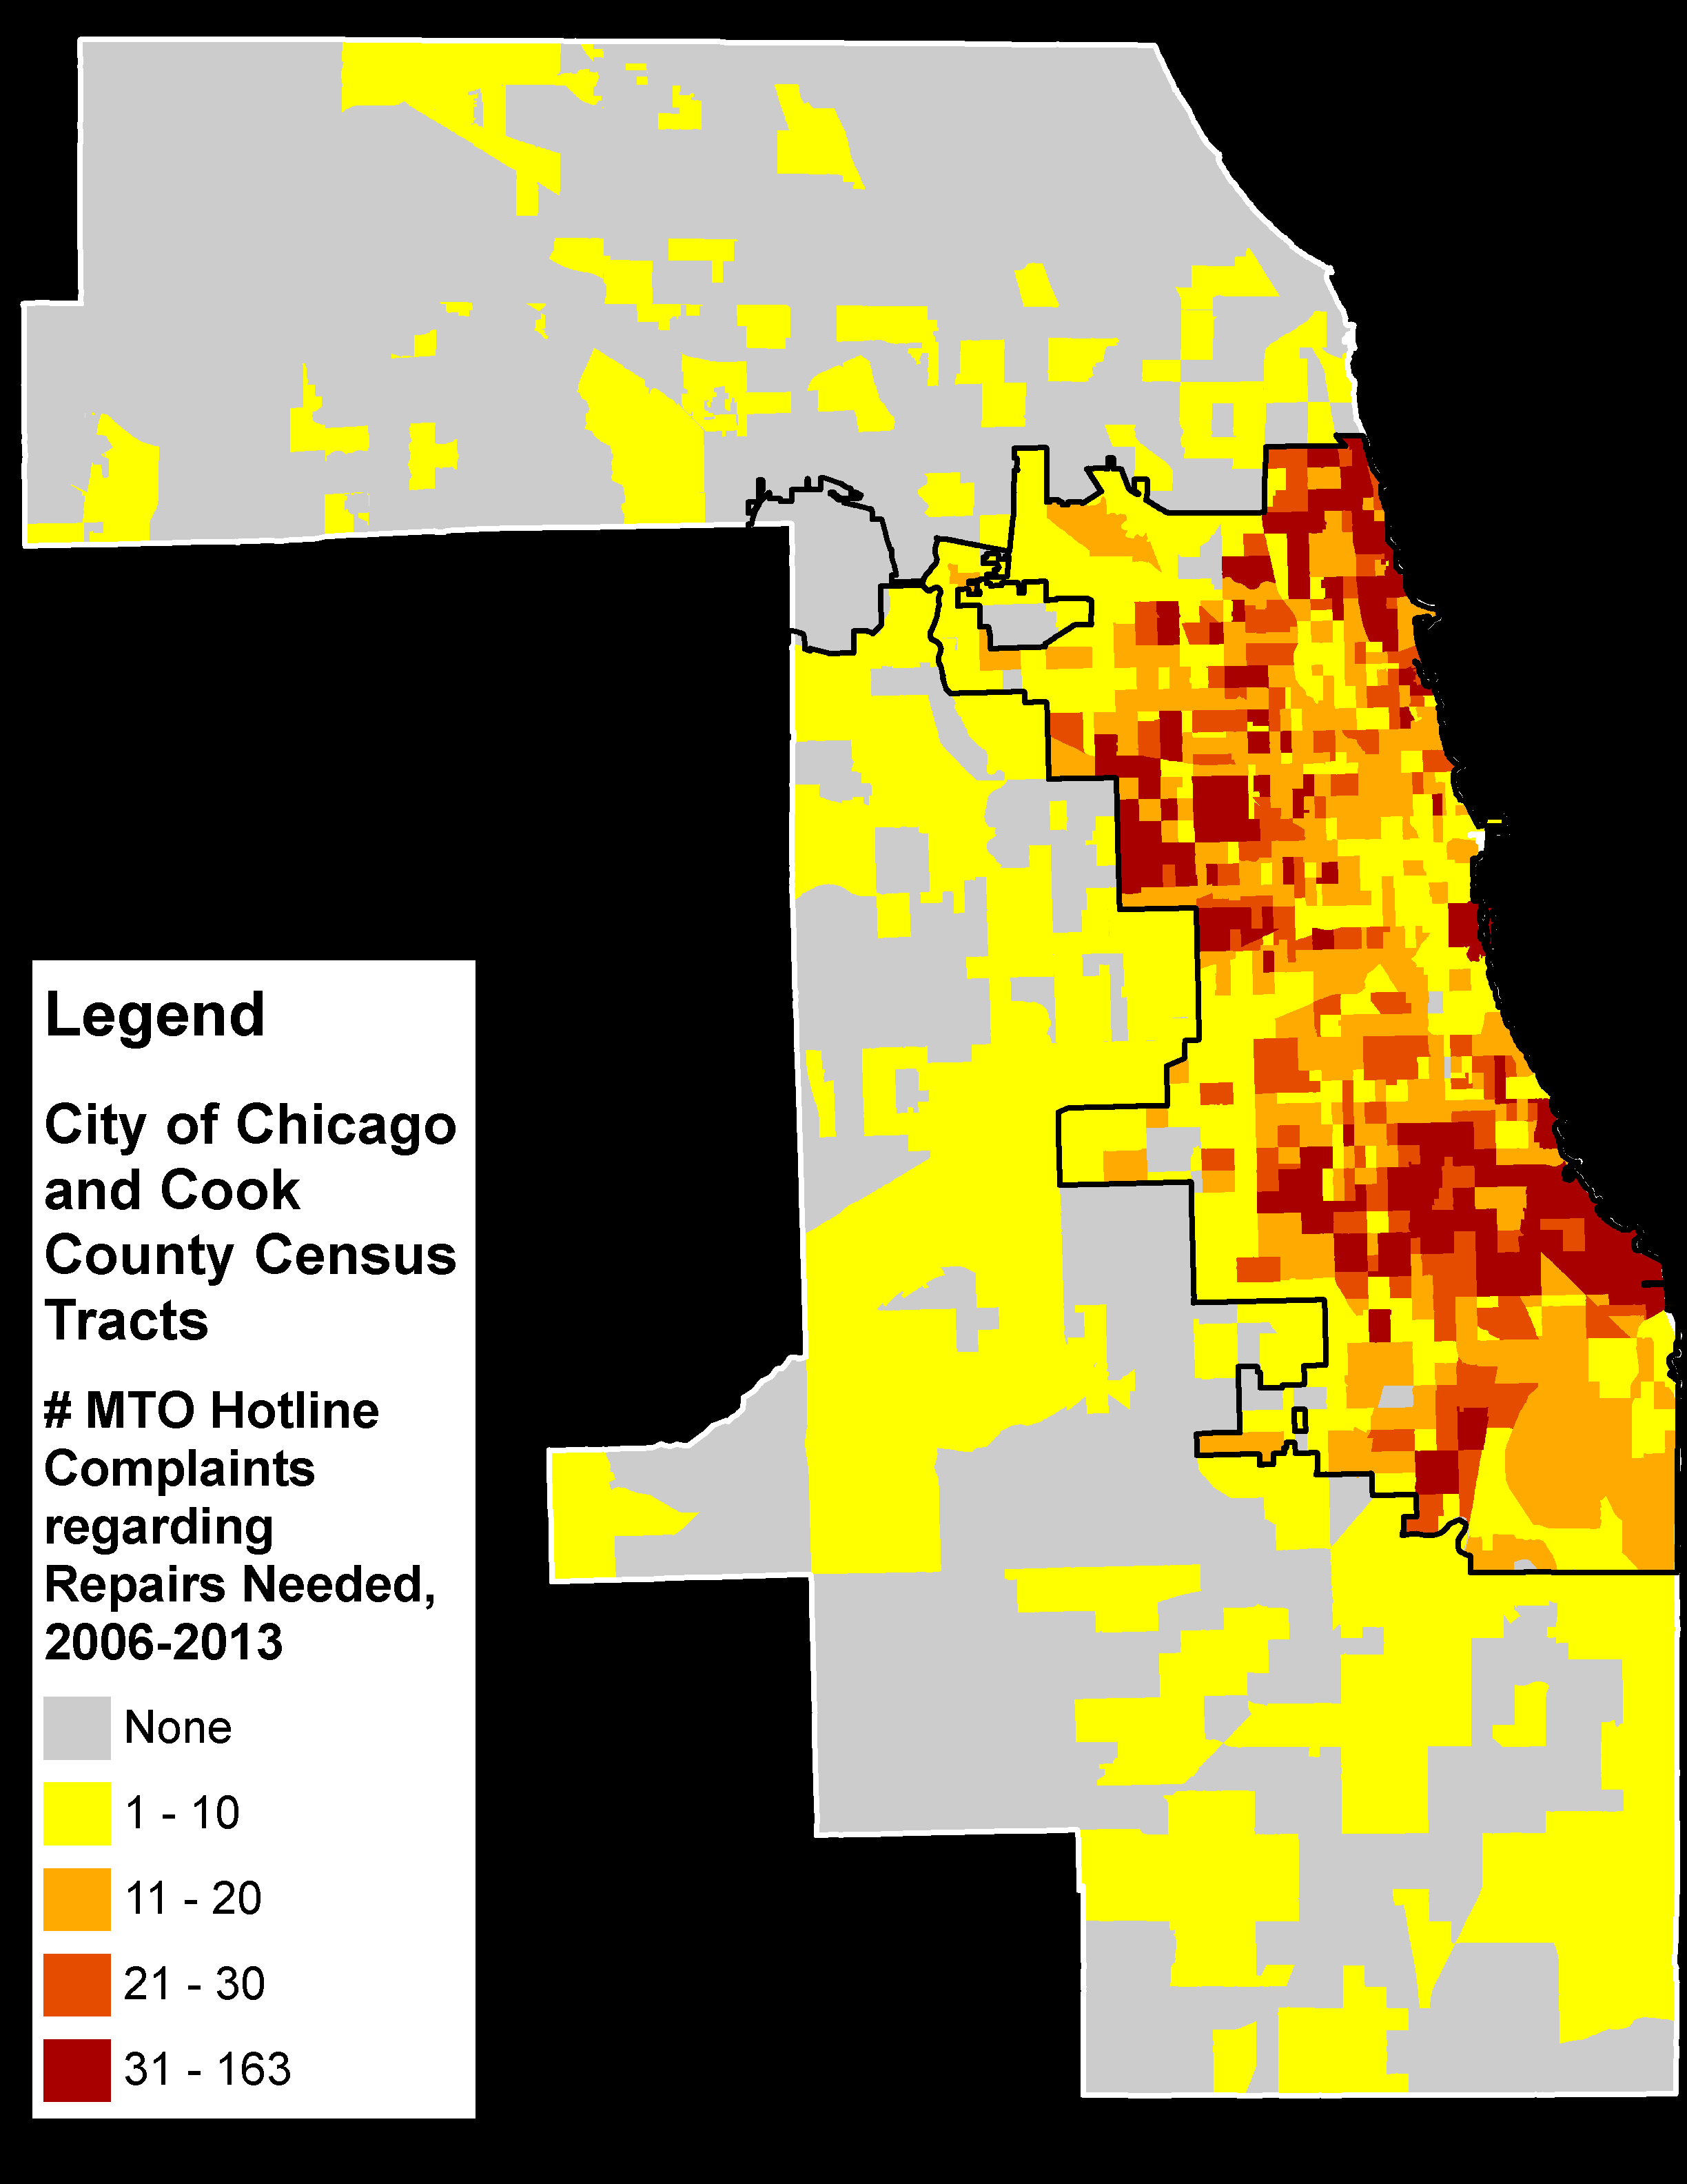
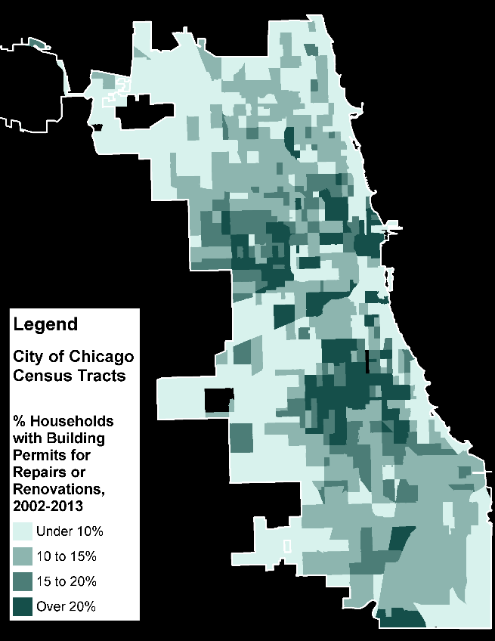
Repairs and Renovations
Metropolitan Tenants Organization MTO Hotline Complaints regarding Necessary Repairs, 2006-2013
Building Permits for Repairs and Renovations, 2002-2013
Tracts
Tracts
Notes:
Physical maintenance and general state of repair are strong indicators of housing conditions. One way to visualize this is with Chicago Permit data for Repairs and Renovations, shown on the left.
Whether high rates of permitting should be seen as positive or negative depends on the hazard in question.
For lead poisoning, for example, it could be either, with lead remediation seen as good, so long as it’s done safely, while the disturbance of paint associated with other renovations may cause hazardous dust exposure.
The map on the right shows Hotline calls to the renter advocacy group, Metropolitan Tenants Organization, regarding homes in need of repair. They receive over 10,000 calls per year, making this a rich and useful dataset for identifying areas with especially prevalent hazards.

Slide 17

Severe Housing Problems
Percentage of households reporting 1-4 of the following problems
  Overcrowding
  High Cost Burden
  Lack of Plumbing or Kitchen facilities
Source: American Housing Survey, 2005-2009
Tracts
Notes:
Data from the US Census Bureau’s Housing Survey measures 4 factors they deem to be Severe Housing Problems. This map shows the distribution rate of households with at least one of these problems.

Slide 18
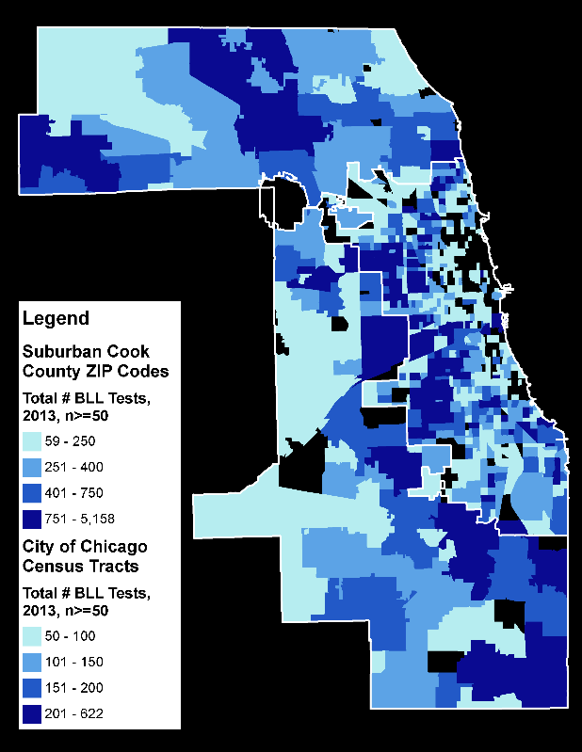

Public Health: Lead Poisoning, 2013
# BLL Tests
EBL > 5 Prevalence
Tracts &
ZIP Codes
Chicago DPH, Cook County DPH & Illinois DPH childhood Lead Poisoning Testing and Prevalence in 2013 (n >=50)
Tracts &
ZIP Codes
Notes:
We’ve covered socioeconomic and demographic factors to indicate vulnerable populations, and seen various ways to understand the quality of the home environment. Now let’s look at some of the major health outcomes we are trying to prevent by addressing unhealthy housing.
Lead poisoning causes are well understood, but we are still reacting to reported EBLs instead of proactively addressing the underlying causes.
The first map on the left shows the number of blood lead level tests done in Chicago and Cook County.
The map on the right shows the rates of tested kids with an elevated blood lead level over 5 micrograms per deciliter. This is where the Census tract level analysis really improves upon past neighborhood level analyses, showing much greater detail.

Slide 19
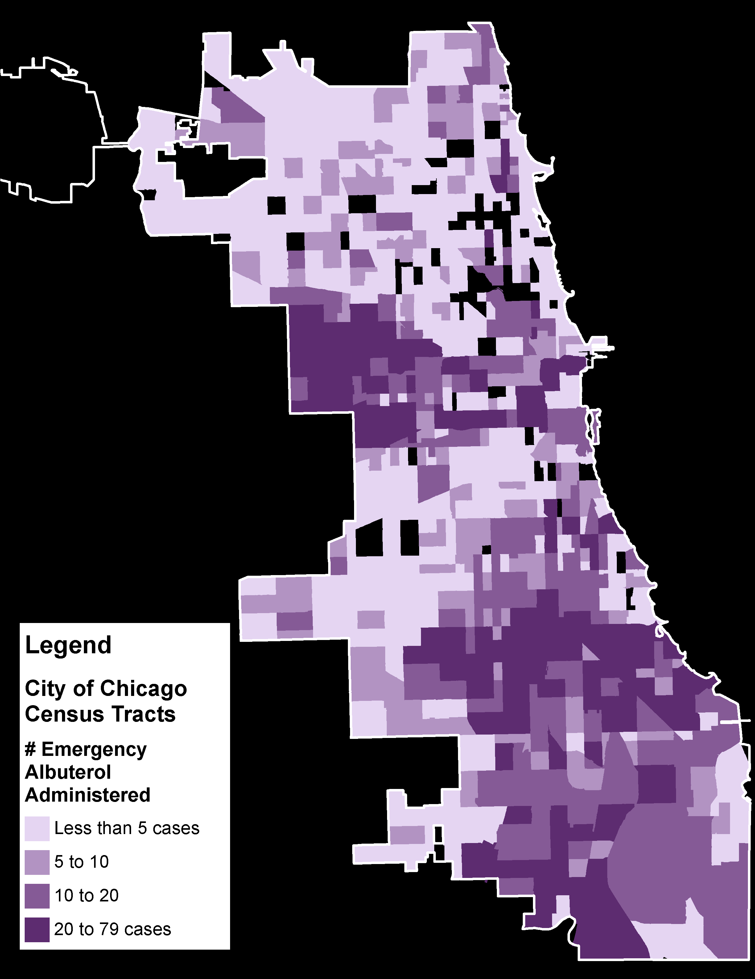
Public Health: Asthma Attacks
Chicago Fire Department ambulance runs where albuterol was administered during an asthma attack in 2013
City of Chicago total = 8,692
  Contains multiple instances of the same patient
Tracts
Notes:
Asthma hospitalizations are one way to show the disease prevalence, but we know the hospital may not be near a patient’s residence. Using data from Chicago Fire Department ambulance runs where albuterol was administered, presumably as a treatment for an asthma attack, we get a map attributing the condition to the patient’s locations, many of which are residences. This pattern shows areas of greatest asthma prevalence.

Slide 20

Public Health: Lung Cancer
Illinois Department of Public Health, Illinois State Cancer Registry, Public Data Set
Cancers of the Lung and Bronchus by ZIP Code,
Diagnosed from 2007-2011
ZIP Codes
Notes:
While cancers of the respiratory system have multiple causes, indoor second hand smoke and radon gas are two serious causes. This map, at the ZIP Code level, shows the most recent data from the State Cancer Registry for Cancers of the Lung and Bronchus.

Slide 21
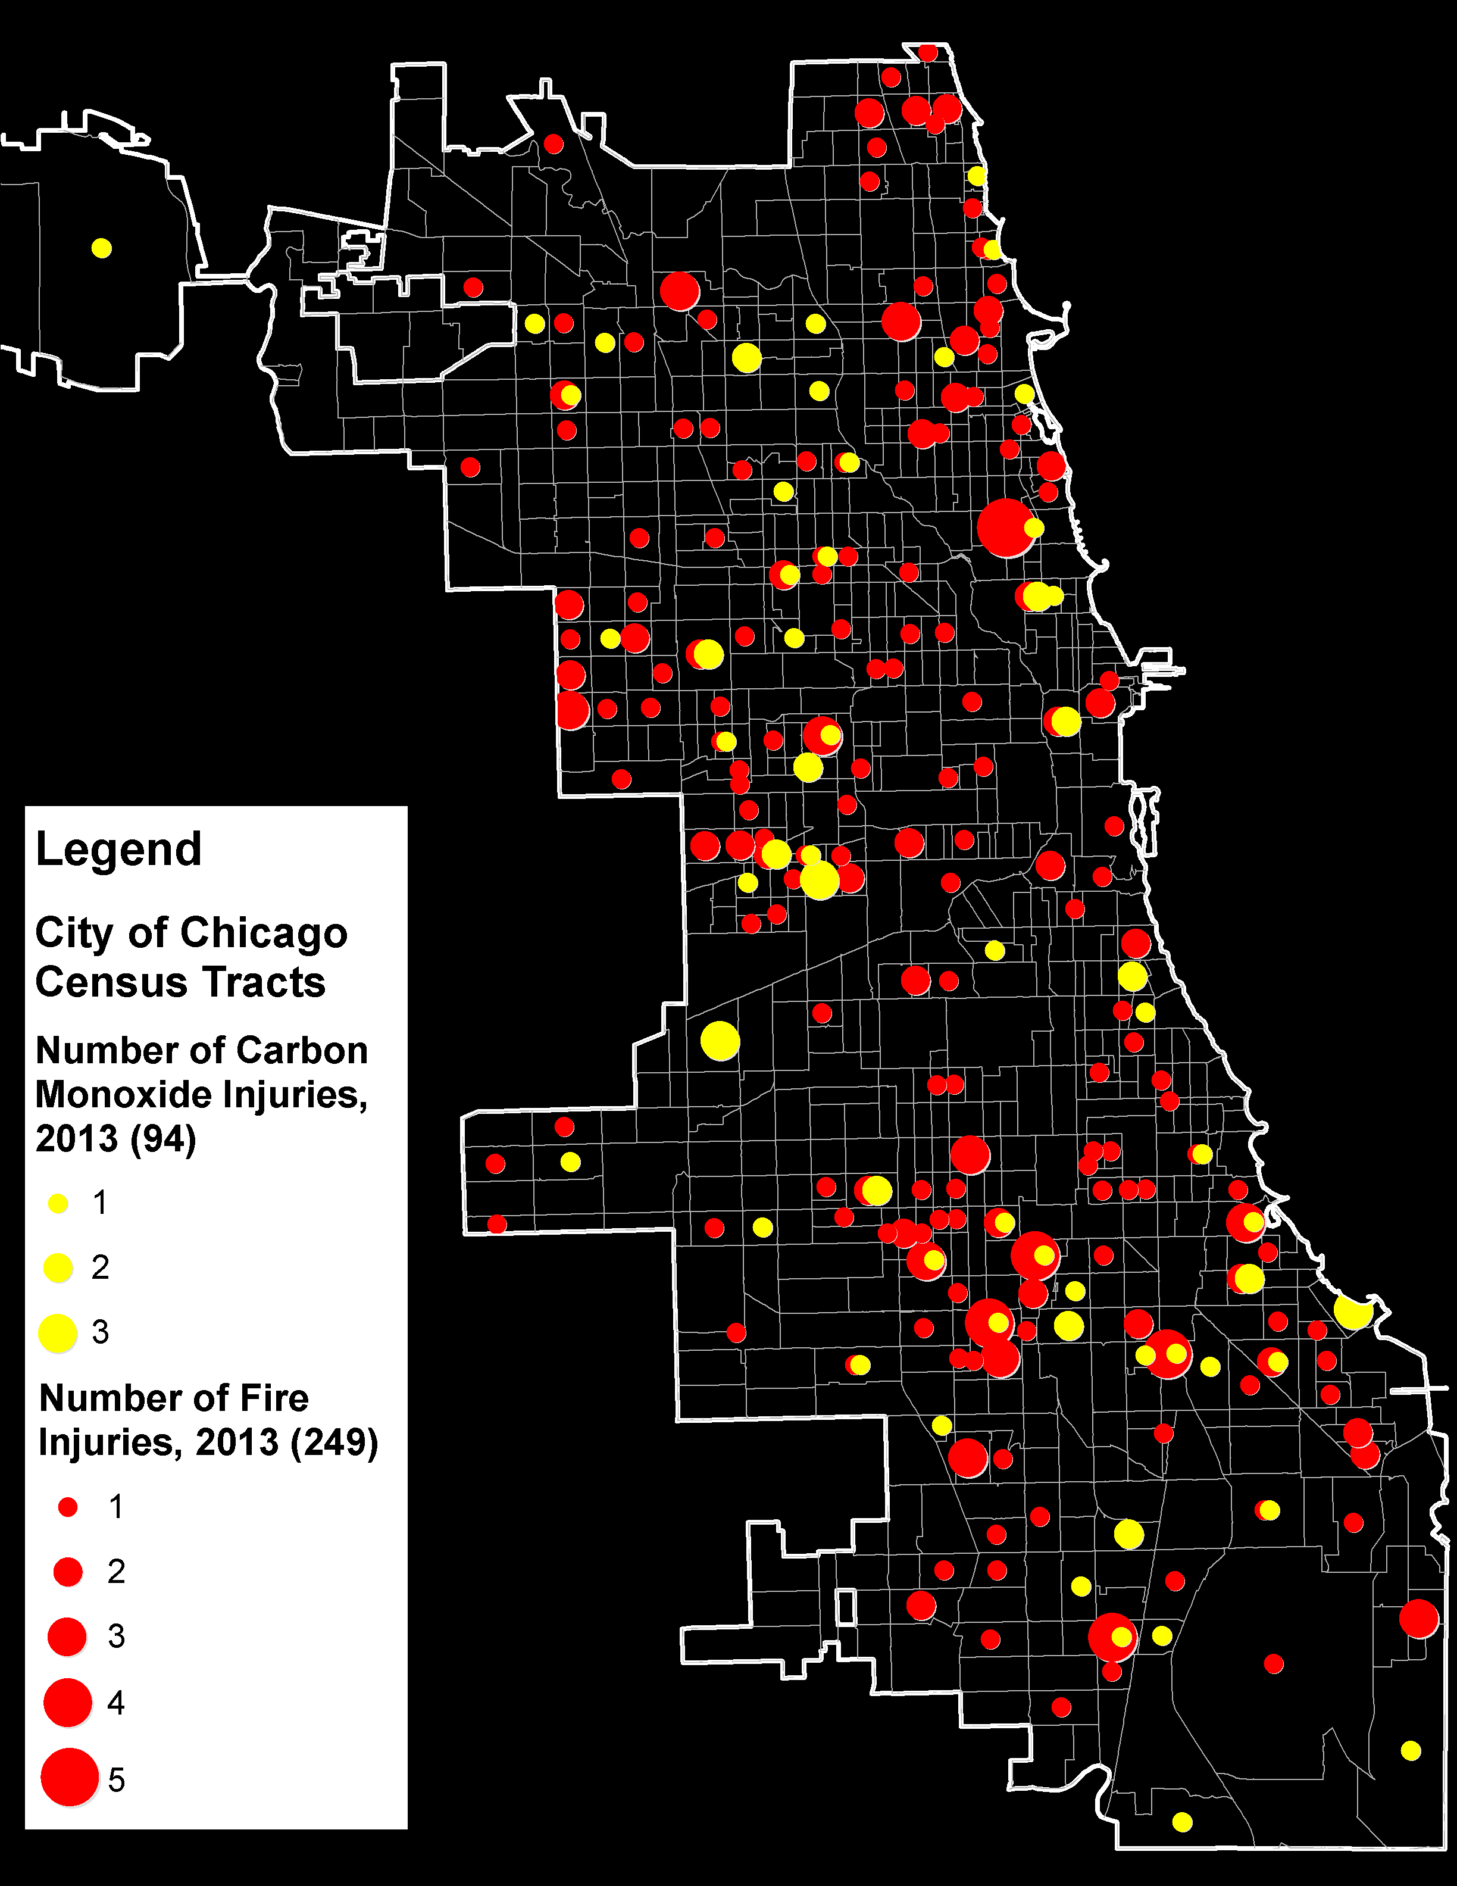
Public Health: Fire and CO Injuries
Chicago Fire Department reported injuries from Carbon Monoxide Poisoning and Fires by Census Tract in 2013
Tracts
Notes:
Two preventable safety hazards are carbon monoxide poisoning and fires. This map shows the incidents of injury due to each last year, with fires in red and CO in yellow.

Slide 22
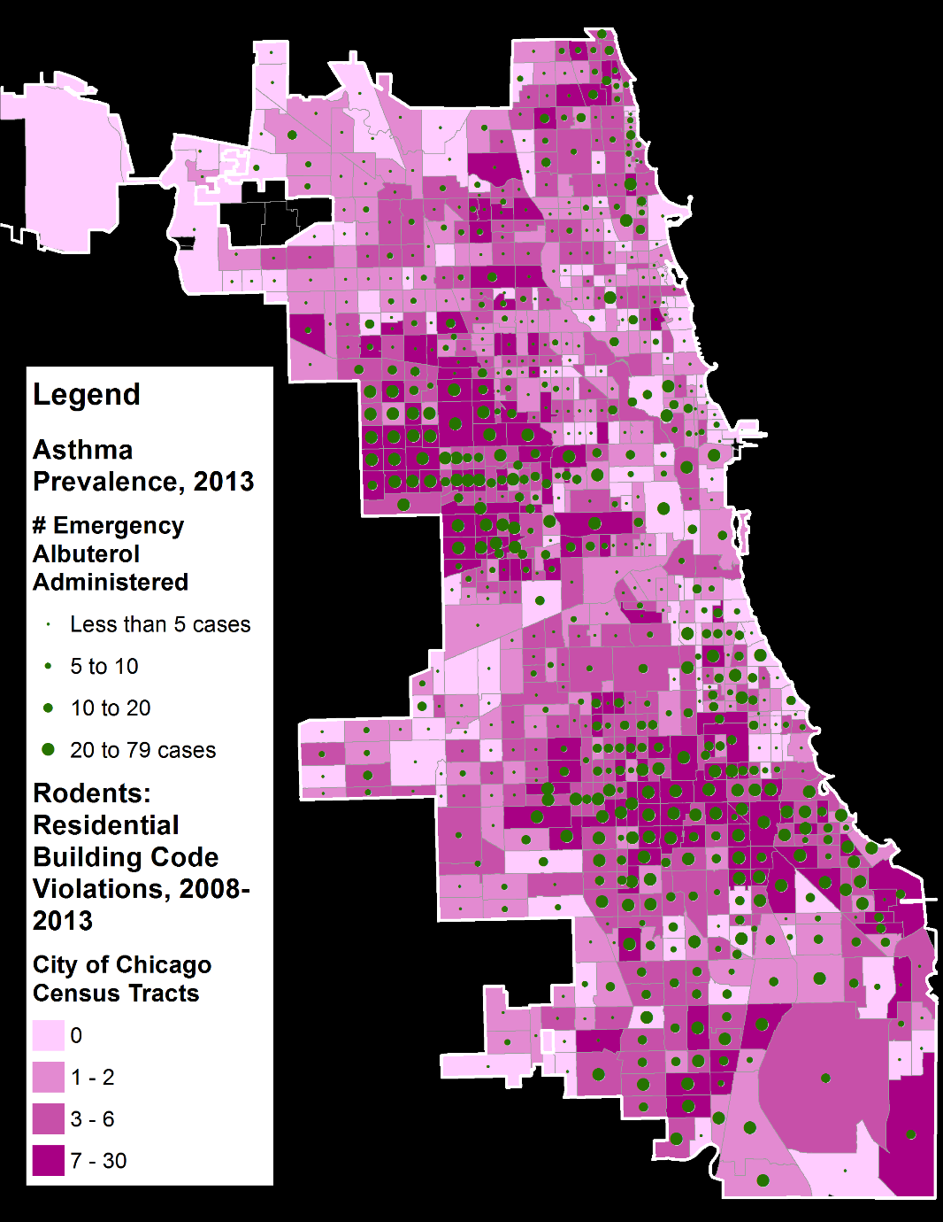
Next Steps: Identifying Areas of Greatest Concern
Targeting areas of overlap
  High incidence of public health concerns
  High incidence of physical environment concerns
Defining the affected populations
  Poor, Young, Uninsured, Disabled
For Example, High Building Code Violations for Rats and Mice coincides with Greater Asthma Prevalence
Notes:
As I said, this set of maps is an intermediate step in deriving particular areas of greatest concern for each hazard. The next step is to overlay health outcomes on maps of physical home problems to verify and quantify the association between them.
We’ll then be able to find the areas of greatest concern and the populations within them, and/or identify what other data is needed.

Slide 23
  Where More Data are Needed
Additional Physical Environment data
  Suburban Cook County municipal data
    Building Code Violations and Complaints
    Repairs and Renovations
Additional Public Health data
  Asthma surveillance data
  Poison Control Center data
  Suburban Cook County municipal data
    EMS/Fire Department data
Current and Historical Remediations & Intervention Programs
Ideally, an Integrated Health and Housing Database
Notes:
A set of problems like this requires many perspectives and multiple sources of information to be synthesized. While this effort went a long way in gathering and organizing data, we still need more to round out the picture.
More than just collecting additional datasets, though, it should be apparent now that there would be enormous value in having an Integrated Health and Housing Information Database System. These types of information should be accessible to renters, physicians, policy makers, and practitioners equally and easily.

Slide 24
Acknowledgements
Special Thanks To:
Nancy Tuchman, Director, Institute of Environmental Sustainability (IES)
Anita Weinberg, Director, ChildLaw Policy Institute, Civitas ChildLaw Center
Katherine Kaufka-Walts, Director, Center for the Human Rights of Children
Phil Nyden, Director, Center for Urban Research and Learning (CURL)
David Van Zytveld, Asst. Director, CURL
Travis O’Rear, GIS Consultant
Teresa Neumann, Research Associate, CURL
Dave Jacobs, National Center for Healthy Housing
Emile Jorgensen, Epidemiologist, CDPH
Deanna Durica, Director, Lead Poisoning Prevention & Healthy Homes Unit, CCDPH
Buddy Bates, Epidemiologist, CCDPH
John Bartlett, Executive Director, Metropolitan Tenants Organization
Chanell Marshall, Green Healthy Homes Initiative
All the other Partners who contributed data and expertise!
Staff of Loyola Centers that made today happen!
Notes:
A special thank you to these supportive, cooperative, encouraging folks, without whom, this would have been impossible.

Slide 25
Access to Maps During Summit
PDF online: http://www.luc.edu/healthyhomes/maps
Getting online
  netreg2.luc.edu to register as a Loyola Guest
  Username: healthyhomes
  Password: luc511942
Notes:
You can access the maps from this talk online at luc.edu/healthyhomes/maps
Thank you!

